Slide 1
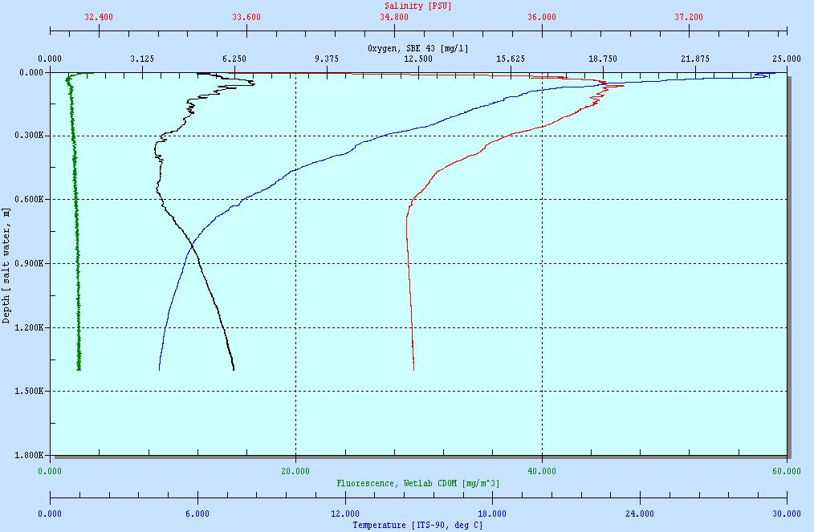
CTD Raw Data
Station: BP-TN05-06
07/26/2010
Lat: 28.570219
Long: -88.322792

