Slide 1
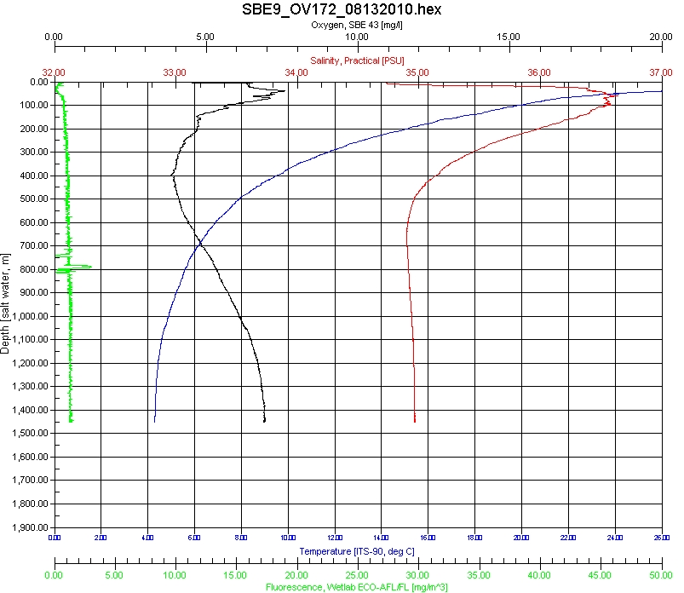
CTD Raw Data
OV172
08/13/2010
Latitude: 27.789960
Longitude: -88.9237620

