Slide 1
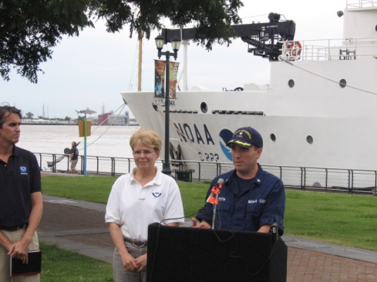
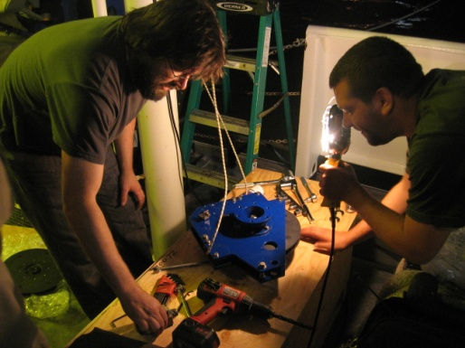
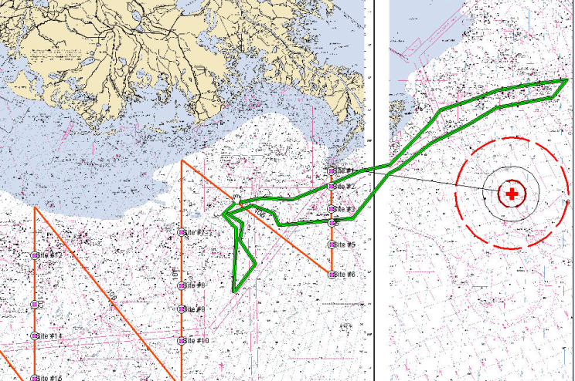
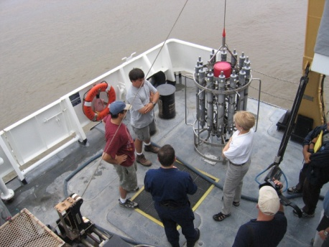
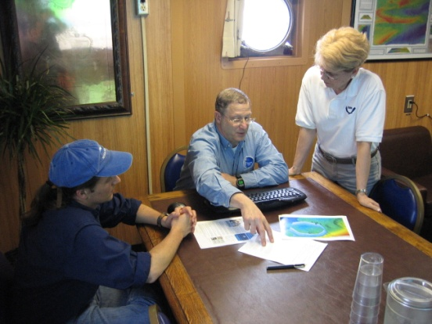
NOAA Ship Thomas Jefferson Deepwater Horizon Response Effort Situation Report: June 2nd, 2010
Operational Highlights:
Friday May 28th – Wednesday June 2nd ,New Orleans, LA: outfitted the ship to enhance scientific capabilities
Augmented scientific complement with acoustician Dr. Larry Mayer and bioacoustician Dr. Alex DeRobertis, oceanographers Dan Torres and Brian Guest, water chemist Jennifer Cragan, analyst Mark Stead
Installed a multi-sensor free-fall fish equipped with a crude oil sensor and sound speed sensor, replaced data cable for stern winch with 1344 m of data cable to support the deployment of a rosette, 2286 m of cable for the CTD winch
June 2nd,1130: visit from the NOAA Administrator Dr. Jane Lubchenco, 1400: Press conference
Sailing delayed to 0600 June 3rd because of delayed shipment of essential water sample collection materials
Incident Location

