Slide 1
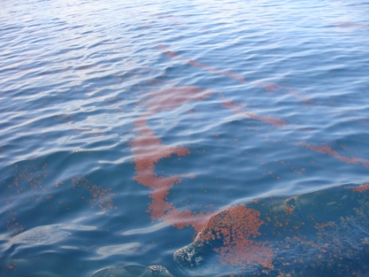
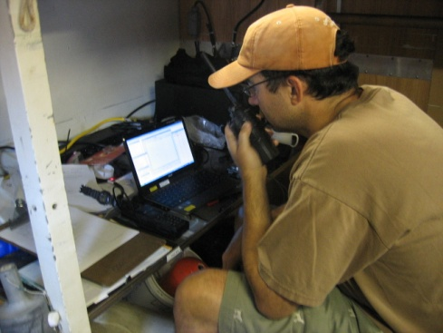
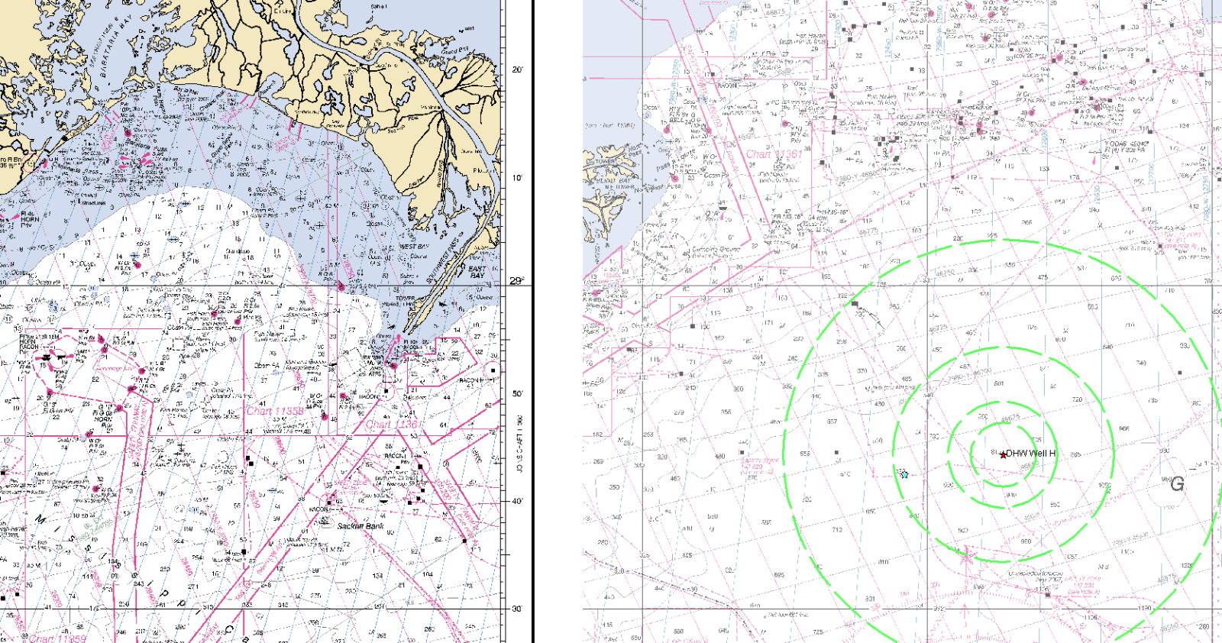
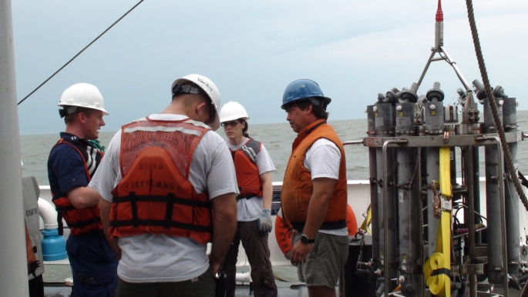
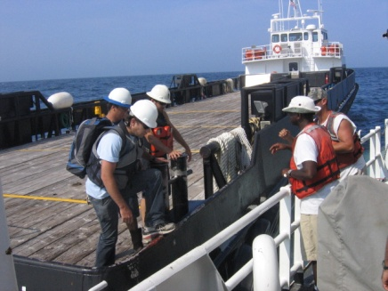
NOAA Ship Thomas Jefferson Deepwater Horizon Response Effort Situation Report: June 5th, 2010
Operational Highlights:
Saturday: Continuing investigation approximately 5 Nm SW of incident location
Collecting acoustic and CTD data in the vicinity of high fluorometer readings and in an area with numerous natural methane seeps
Three deep water CTD casts, max depth of 1212 m
Access to work inside 5NM line by SIMOPS not granted with potential entry Sunday
Transferred water samples to shore via crew boat
1900 local position 28-42.54 N 88-32.31 W
Outlook: Water sampling, CTD and acoustic work inside 5NM
Incident Location
TJ @ 1900
Operations Area

