Slide 1
Use of Native Urchins as a Restoration Tool for Coral Reefs
Jono Blodgett
Dept. of Land and Natural Resources
Division of Aquatic Resources

Slide 2
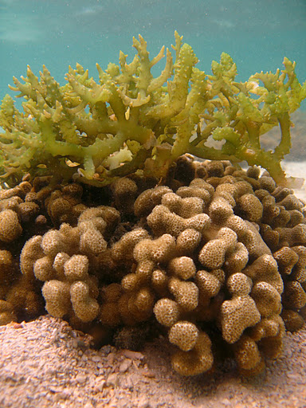
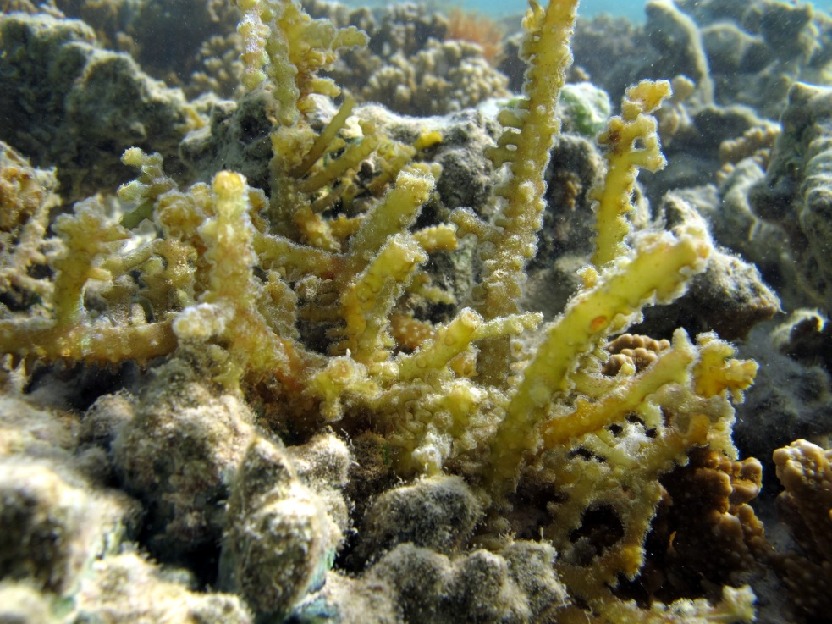
Introduction to the Enemy
Main species of concern:
Kappaphycus spp.
Eucheuma spp.
Smothering Seaweed
Notes:
Common name: Gorilla ogo and Smothering Seaweed
Both introduced as aquaculture candidate in 70’s from the Phillippines
Fills reef cracks & crevices; reducing habitat for fish & invertebrates
Overgrows and smothers native coral and algae
Accumulates on beaches, depressions & shallow areas

Slide 3
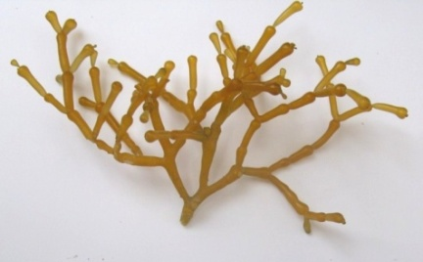
Introduction to the Enemy
Main species of concern:
Gracilaria salicornia
Gorilla seaweed (ogo)
Acanthophora spicifera
Spiny or Prickly seaweed

Slide 4
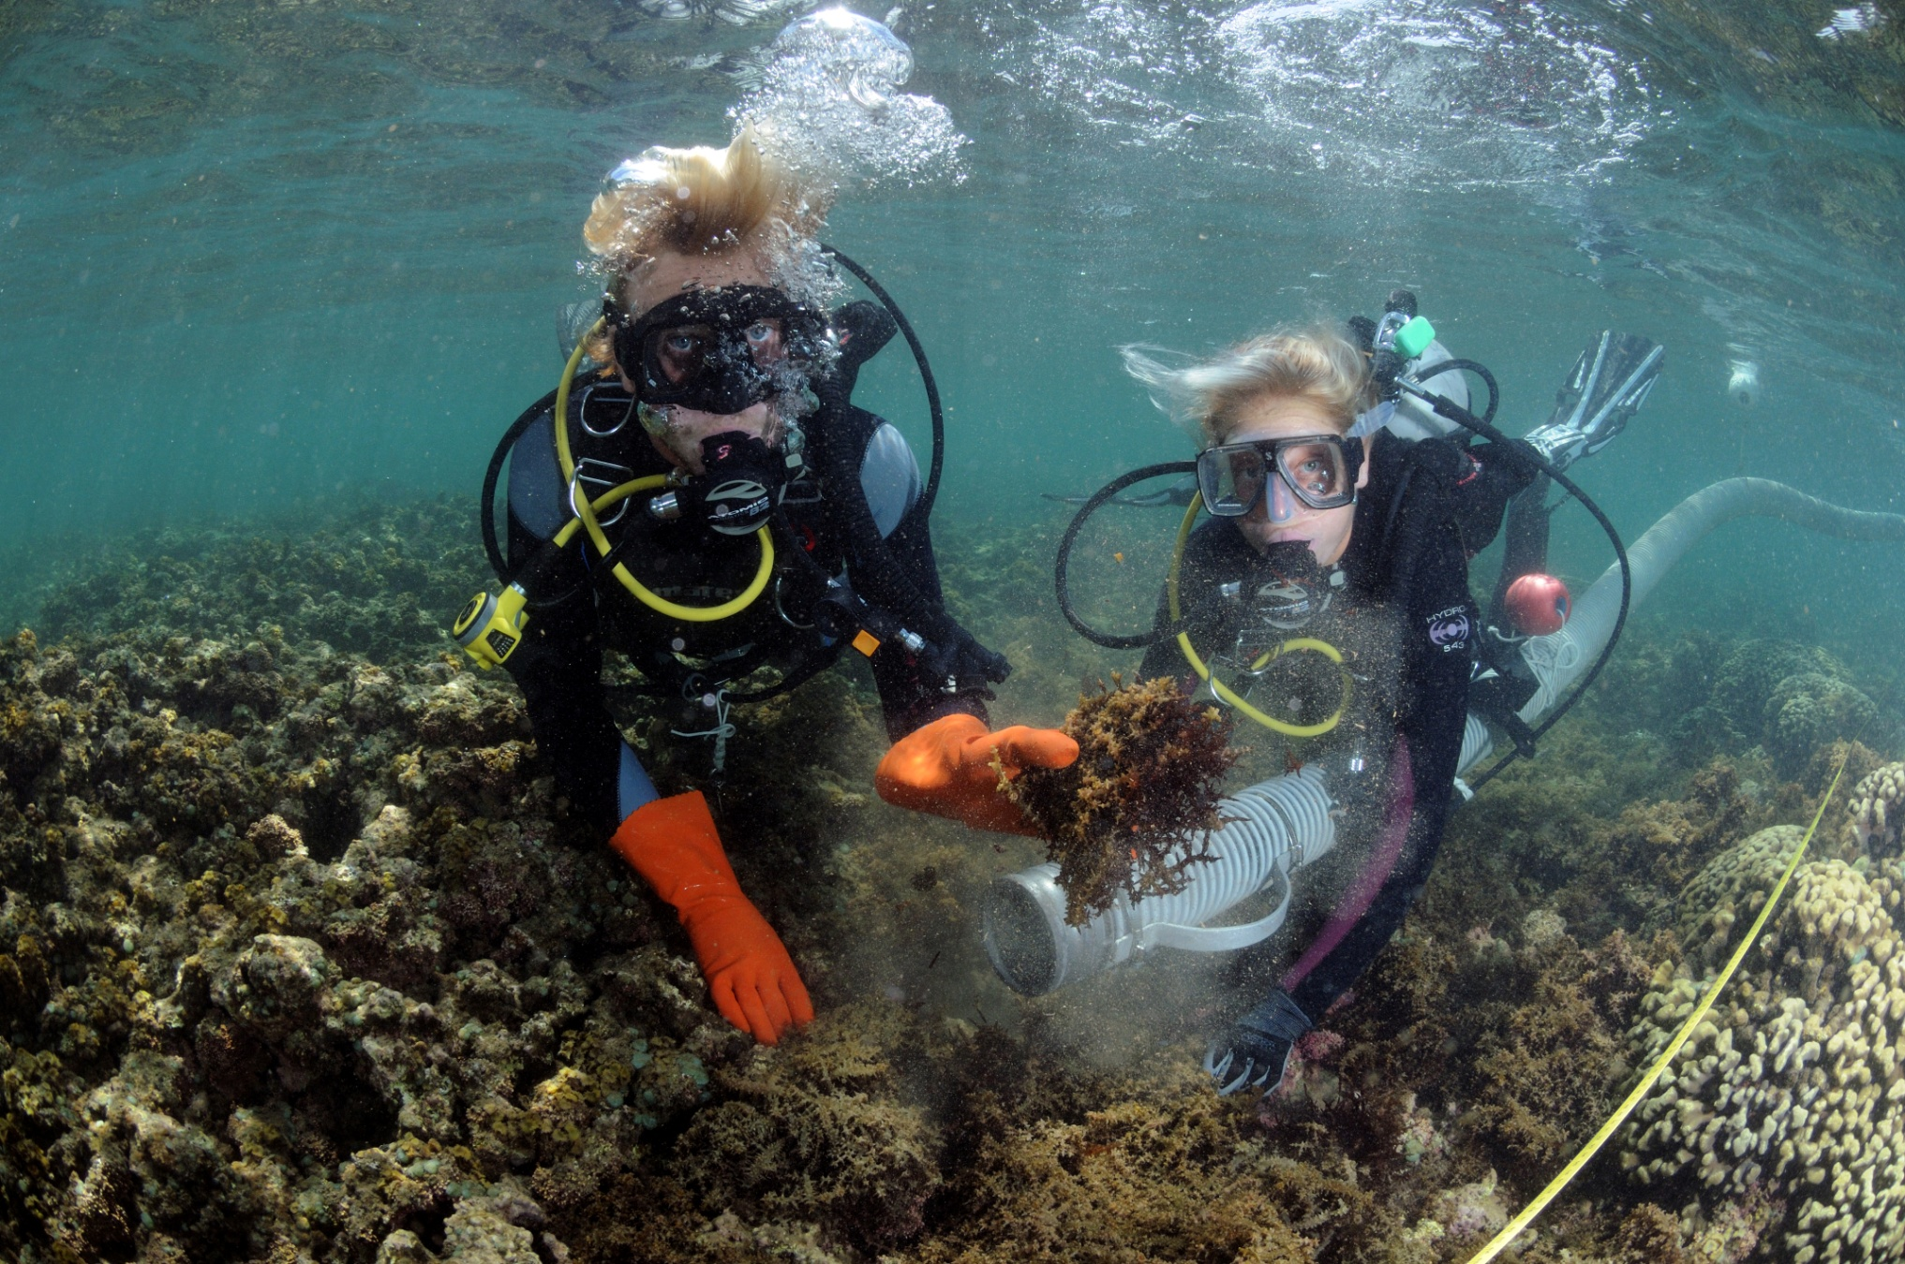
Photo: Sterling Kaya

Slide 5
Algae Removal

Slide 6
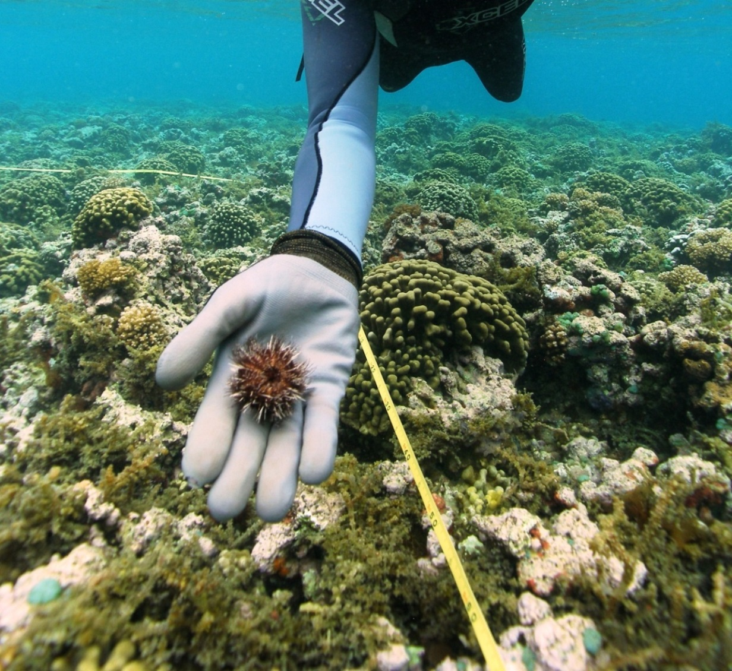
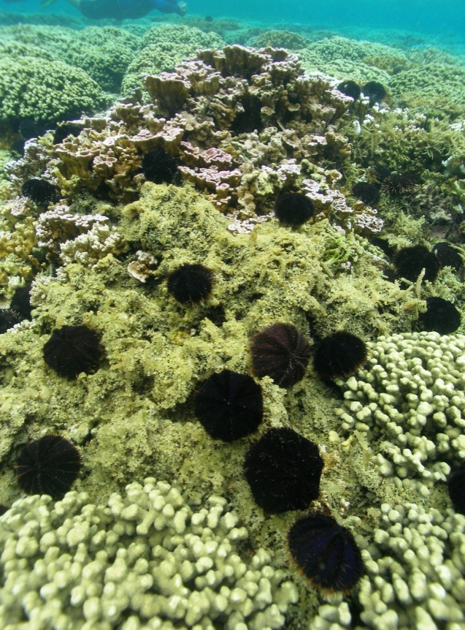
Juvenile Urchin Outplanting
Collector Urchin, “hawae,” Tripneustes gratilla

Slide 7
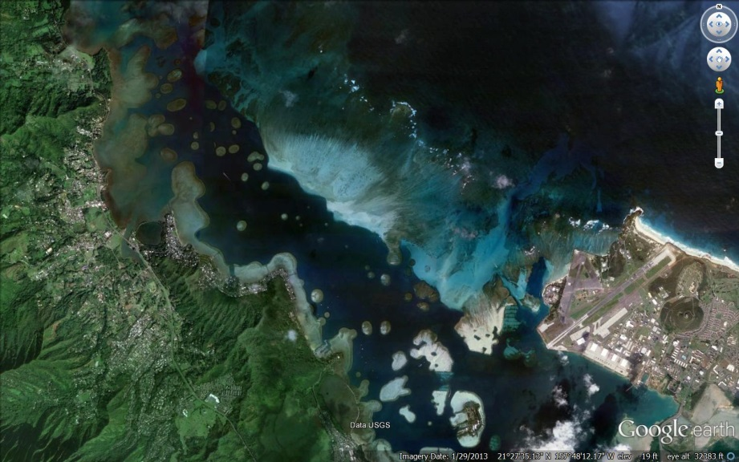
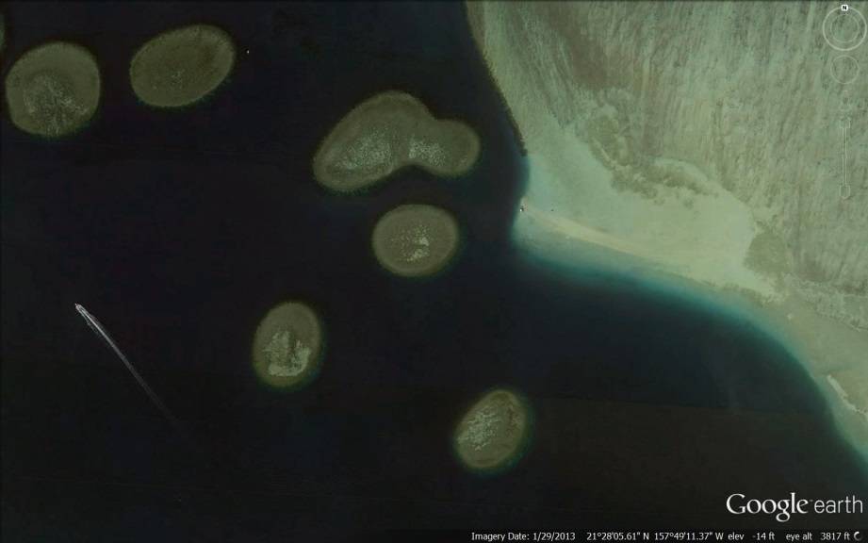
Current Project
Treatment = Removal & Biocontrol
4 Patch Reefs in Central KBay
~64,200 m² (15.9 acres)
3 managed (51,000 m²)
1 control
Hatchery Raised Urchins
Juveniles outplanted at ~15-20mm diameter
Target density ~2 urchins/m²
No “herding”

Slide 8
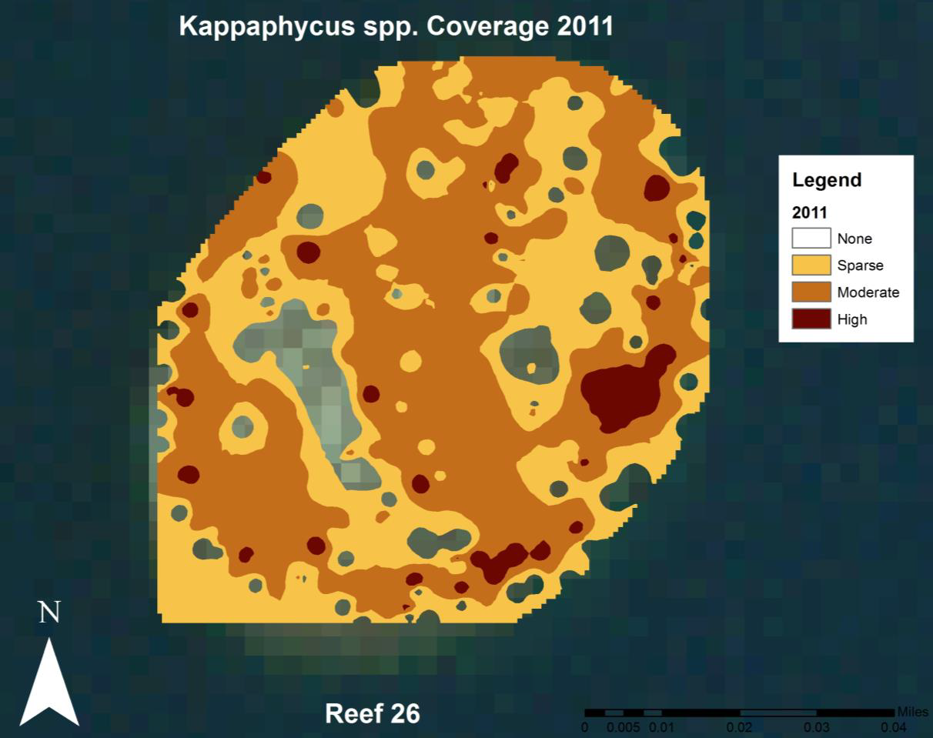
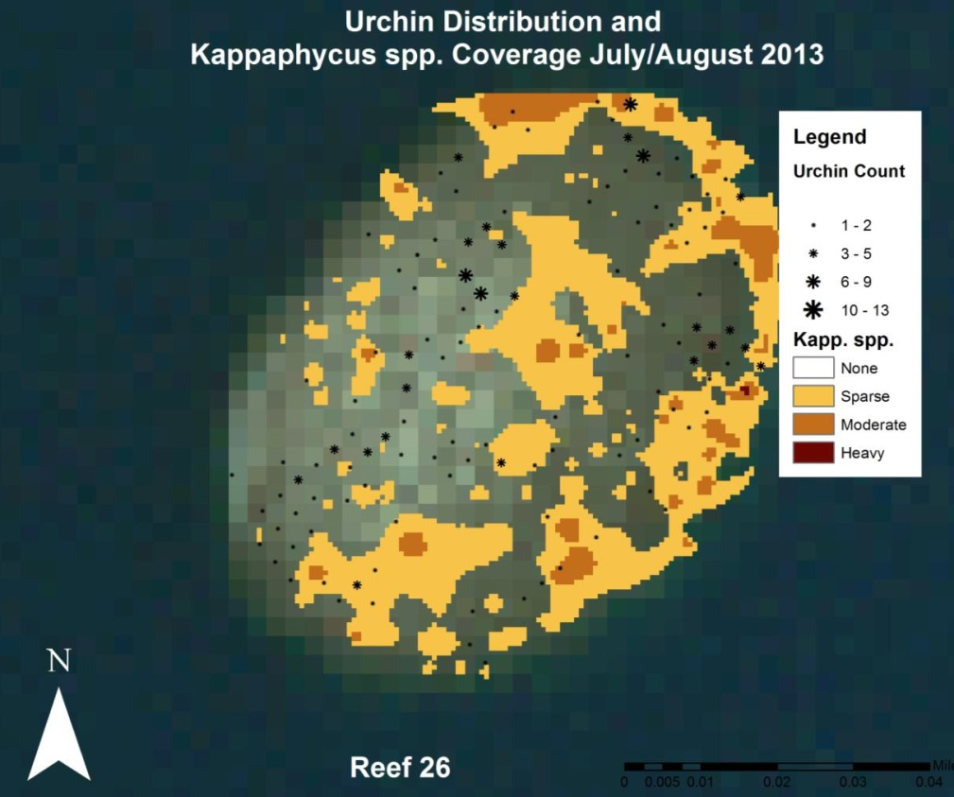
Preliminary Results
Reef 26: Kappaphycus/Eucheuma spp
~12,000 m² (~3 acres)
11,053 lbs (5,014 kg) of K/E removed
~42,000 hatchery raised juvenile urchins outplanted

Slide 9
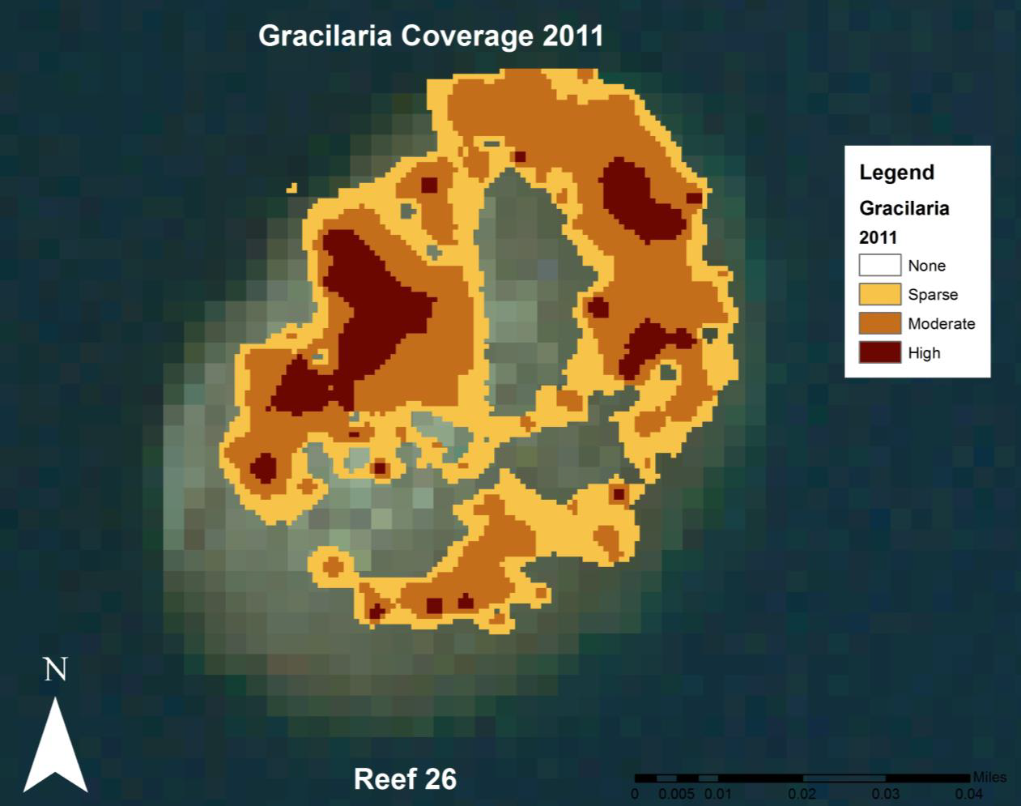
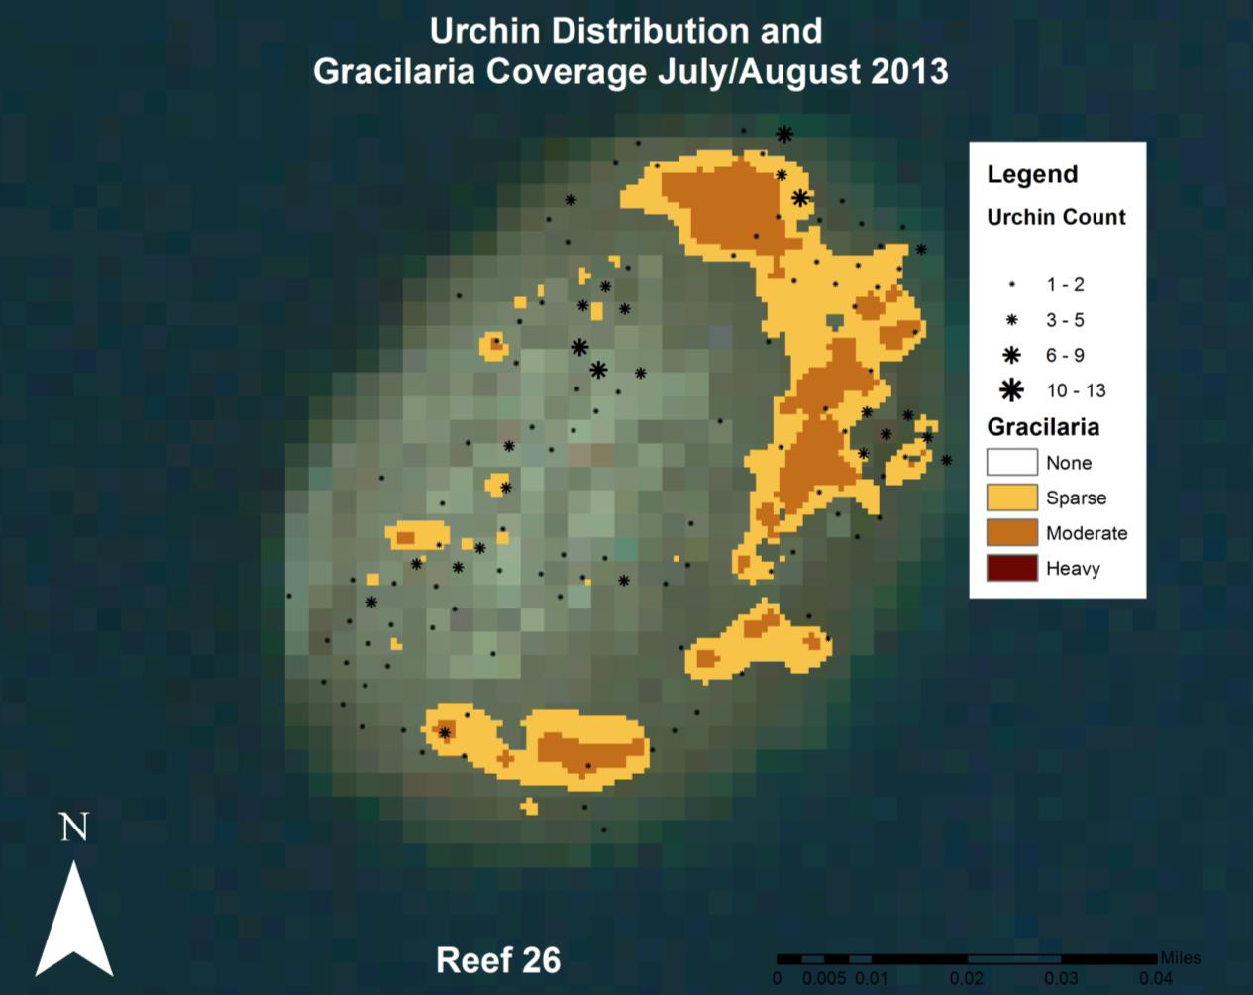
Preliminary Results
Reef 26: Gracilaria salicornia
~12,000 m² (~3 acres)
Only small amounts mechanically removed
~42,000 hatchery raised juvenile urchins outplanted

Slide 10
Preliminary Results

Slide 11
Preliminary Results
AS=Acanthophora spicifera, GS=Gracilaria salicornia, K/E=Kappahphycus/Euchema

Slide 12
Preliminary Results
AS=Acanthophora spicifera, GS=Gracilaria salicornia, K/E=Kappahphycus/Euchema

Slide 13
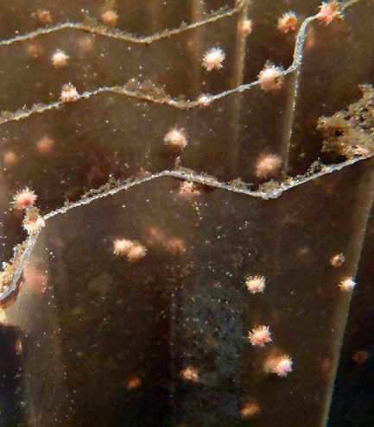
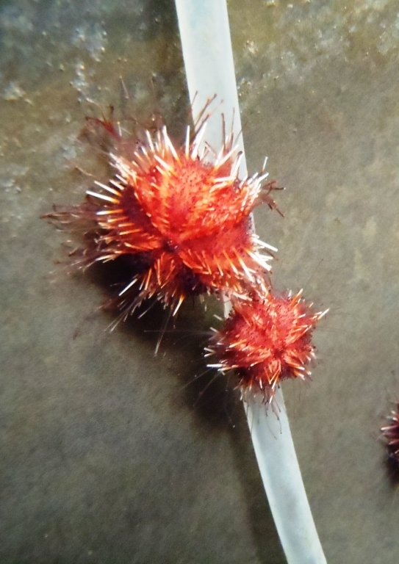
Hatchery Production
2012: 60,000 urchins released
2013 Jan – June: 27,670 (~70,000 expected for 2013)
Completed renovations doubling algae production

Slide 14
Future Work
Refine management tools
Targeted strategies for habitat and species
From Jokiel's Illustrated Scientific Guide to Kaneohe Bay. Typescript. 65 pp.

Slide 15
Future Work
Refine management tools
Determine optimal urchin density, outplant size
Determine if “maintenance density” is effective

Slide 16
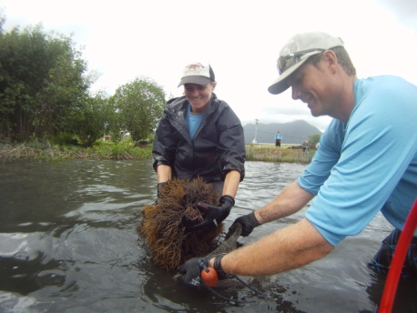
Mahalos!
AIS Monitoring, Super Sucker and Urchin Hatchery Crews
Work funded in part by:
NOAA Coral Reef Conservation Agreement
USFW Sport Fish Restoration Program
NOAA Estuary Restoration Act
Hawaii Invasive Species Council

Slide 17
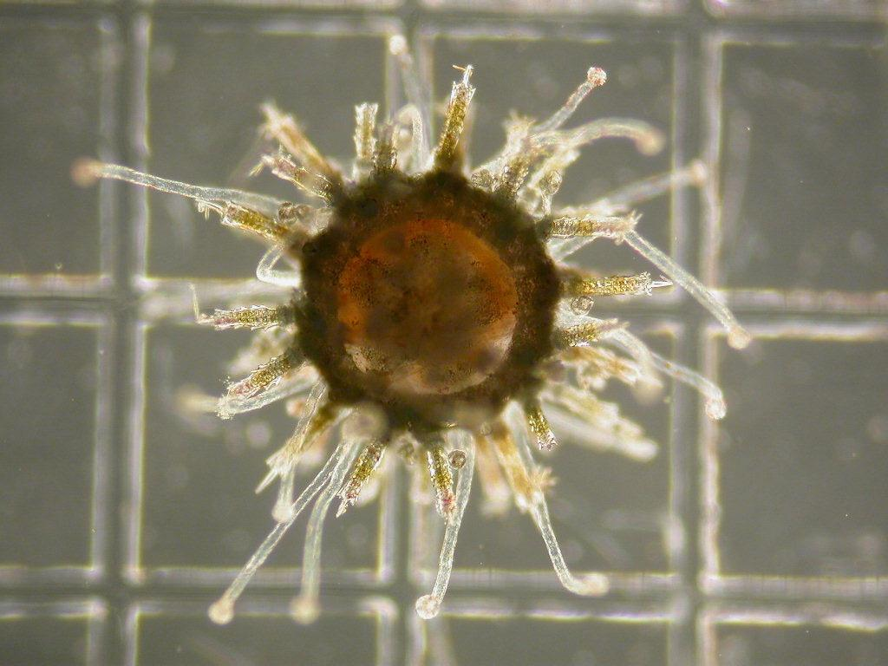
Questions?
Check us out on Facebook: www.facebook.com/noalienseaweed www.facebook.com/sea.hatchery
Notes:
17

