Slide 1
Temporal changes of surface ocean pH from 1770 to 2100
Citation: Jiang, L.-Q., B. R. Carter, R. A. Feely, S. Lauvset, and A. Olsen (2019), Surface ocean pH and buffer capacity: past, present and future, Nature Scientific Reports, 9:18624, doi:10.1038/s41598-019-55039-4.

Slide 2
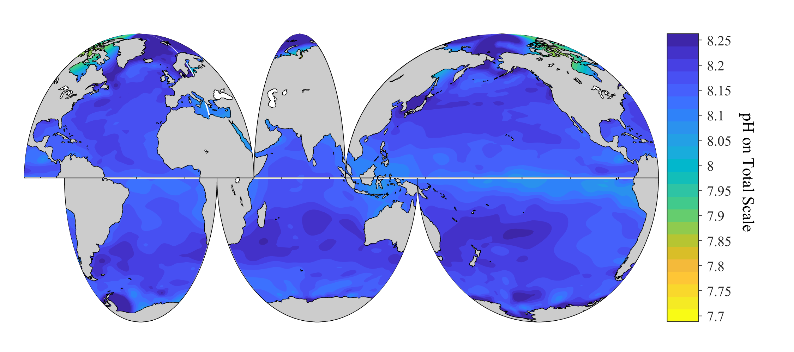
Annually averaged surface pH in 1770

Slide 3
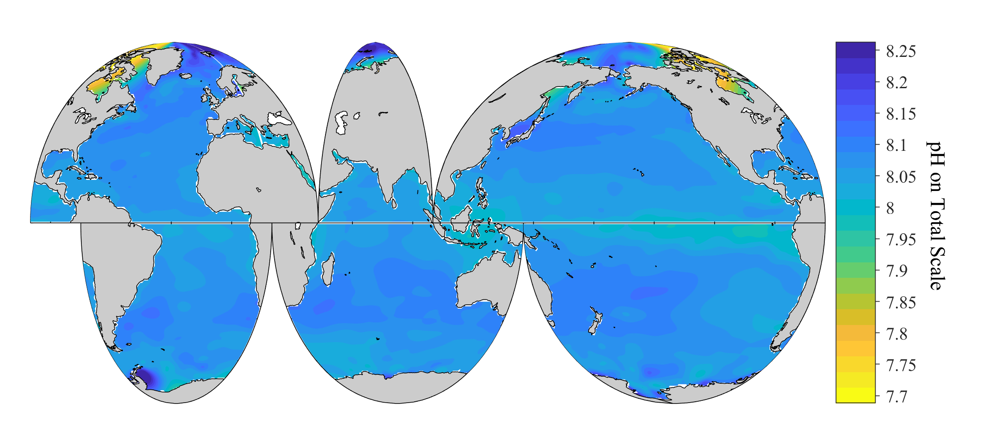
Annually averaged surface pH in 2000

Slide 4
Annually averaged surface pH in 2010

Slide 5
Annually averaged surface pH in 2020

Slide 6
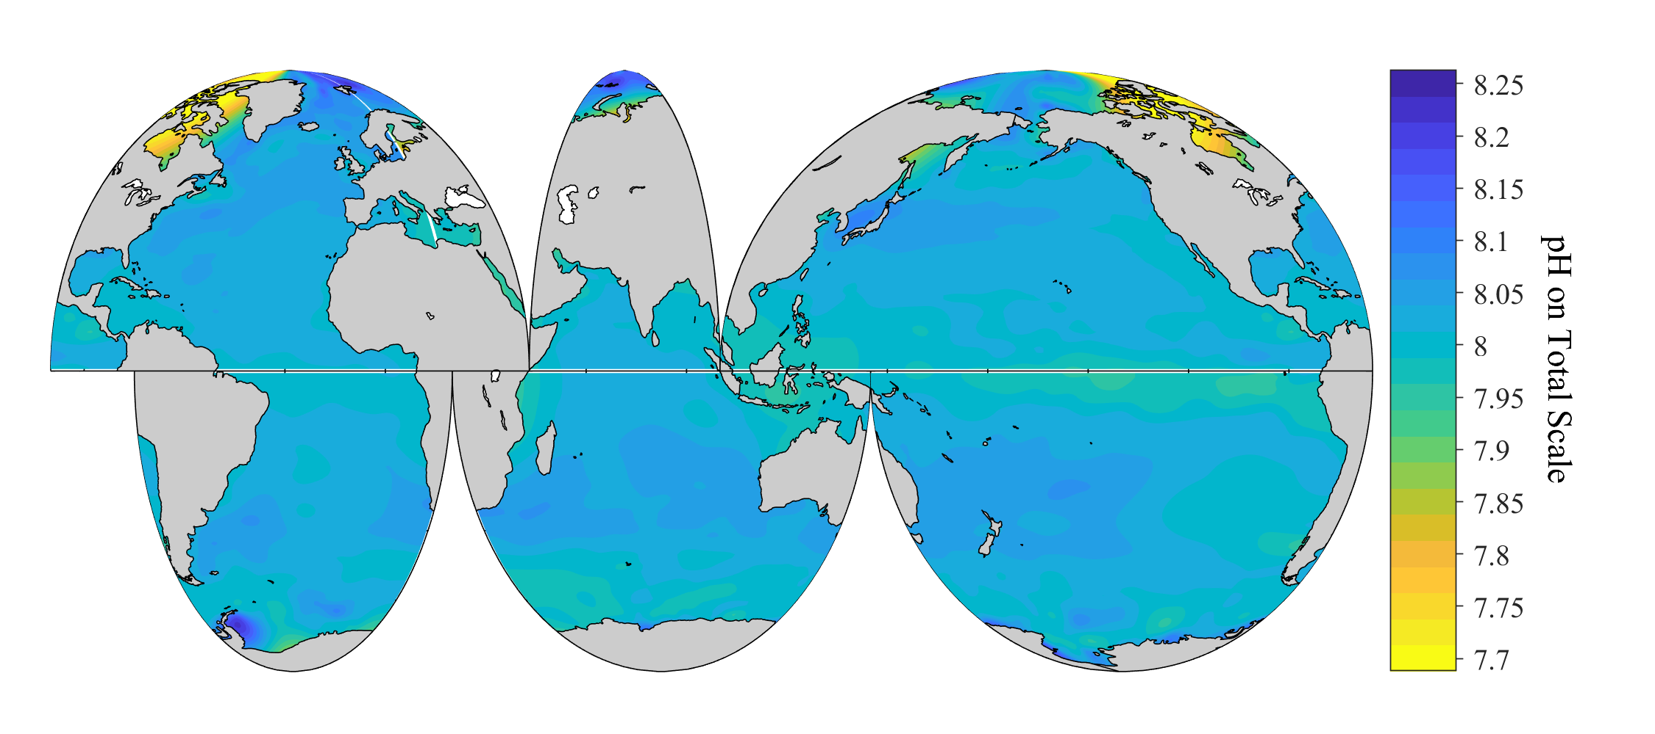
Annually averaged surface pH in 2030

Slide 7
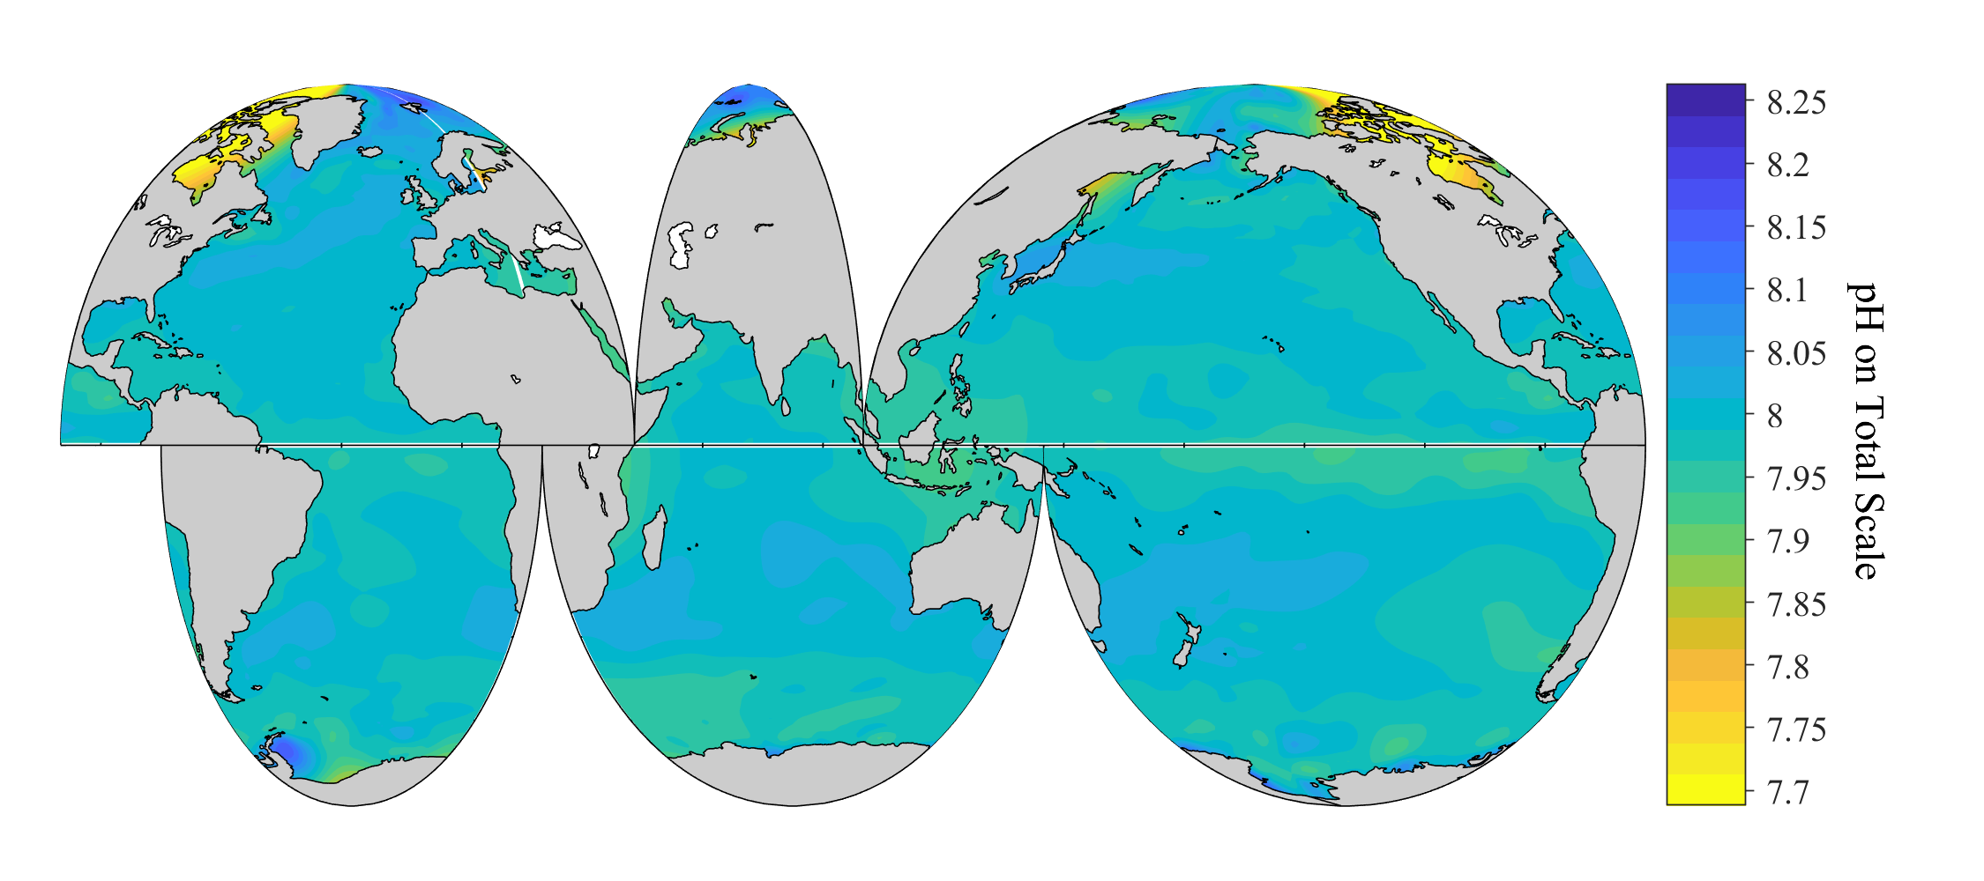
Annually averaged surface pH in 2040

Slide 8
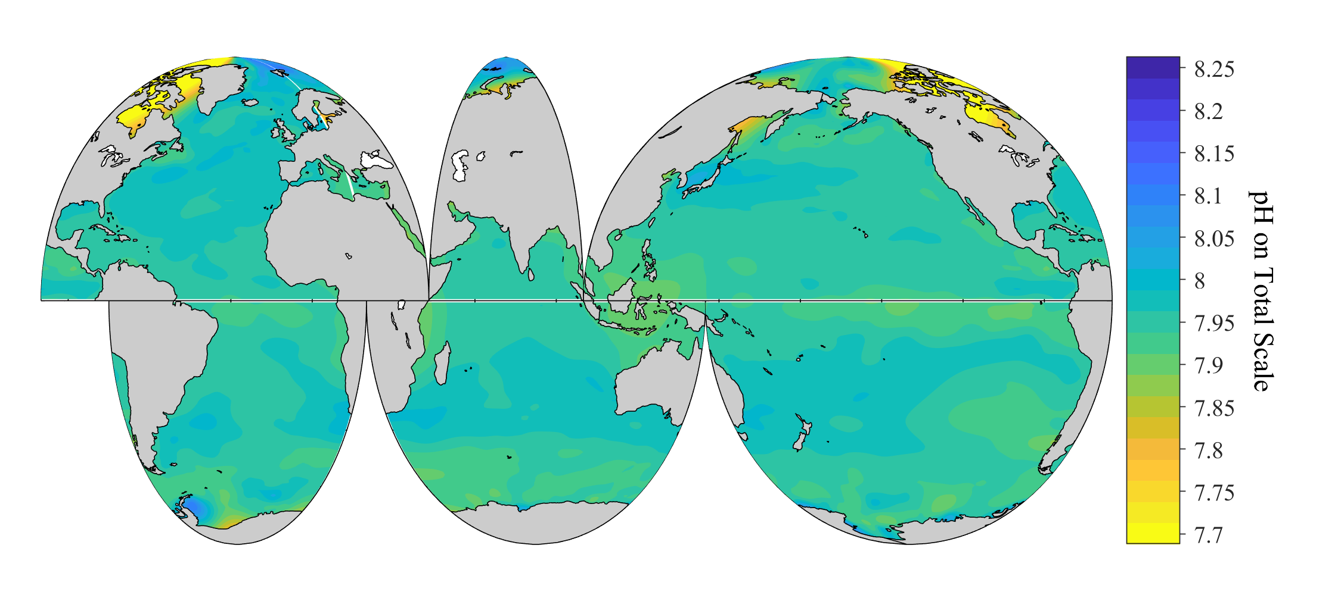
Annually averaged surface pH in 2050

Slide 9
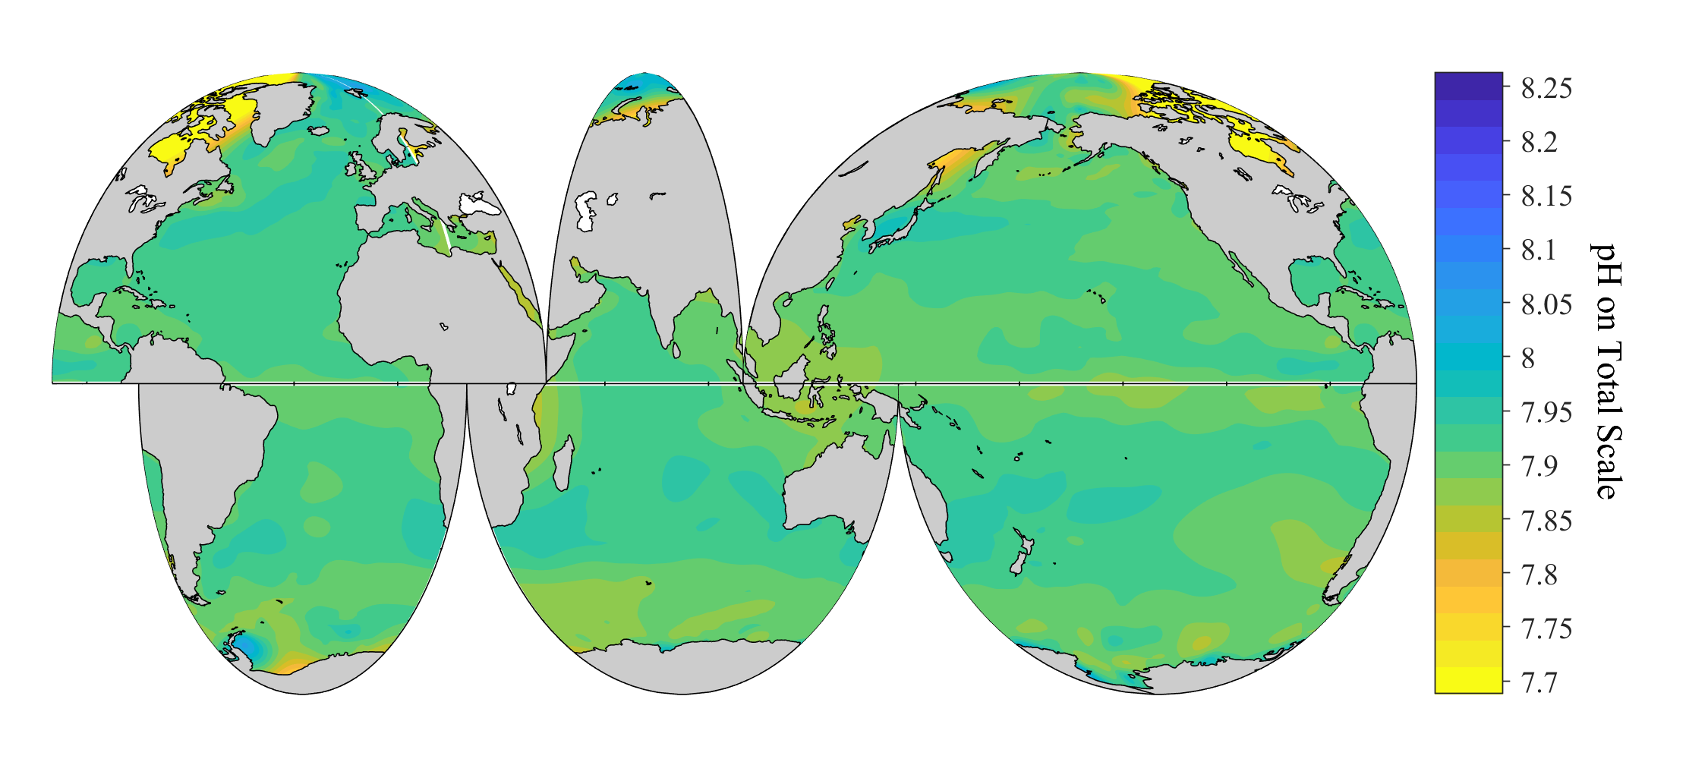
Annually averaged surface pH in 2060

Slide 10
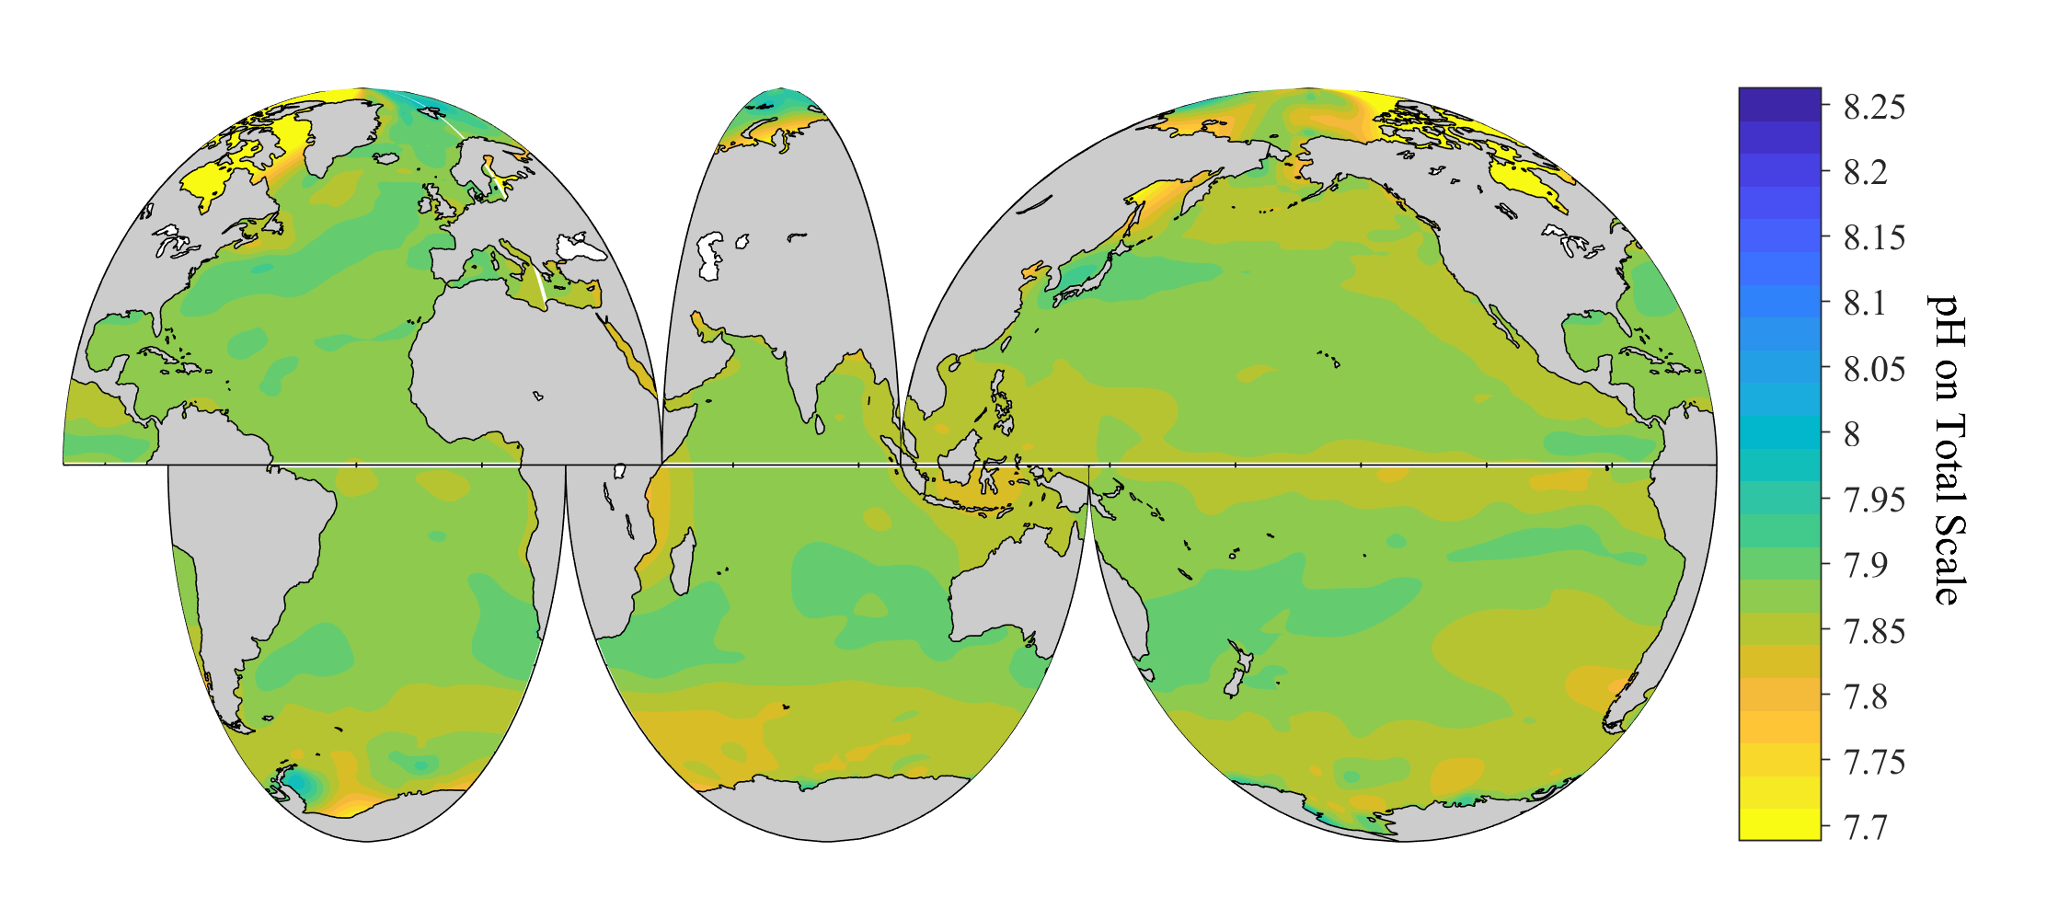
Annually averaged surface pH in 2070

Slide 11
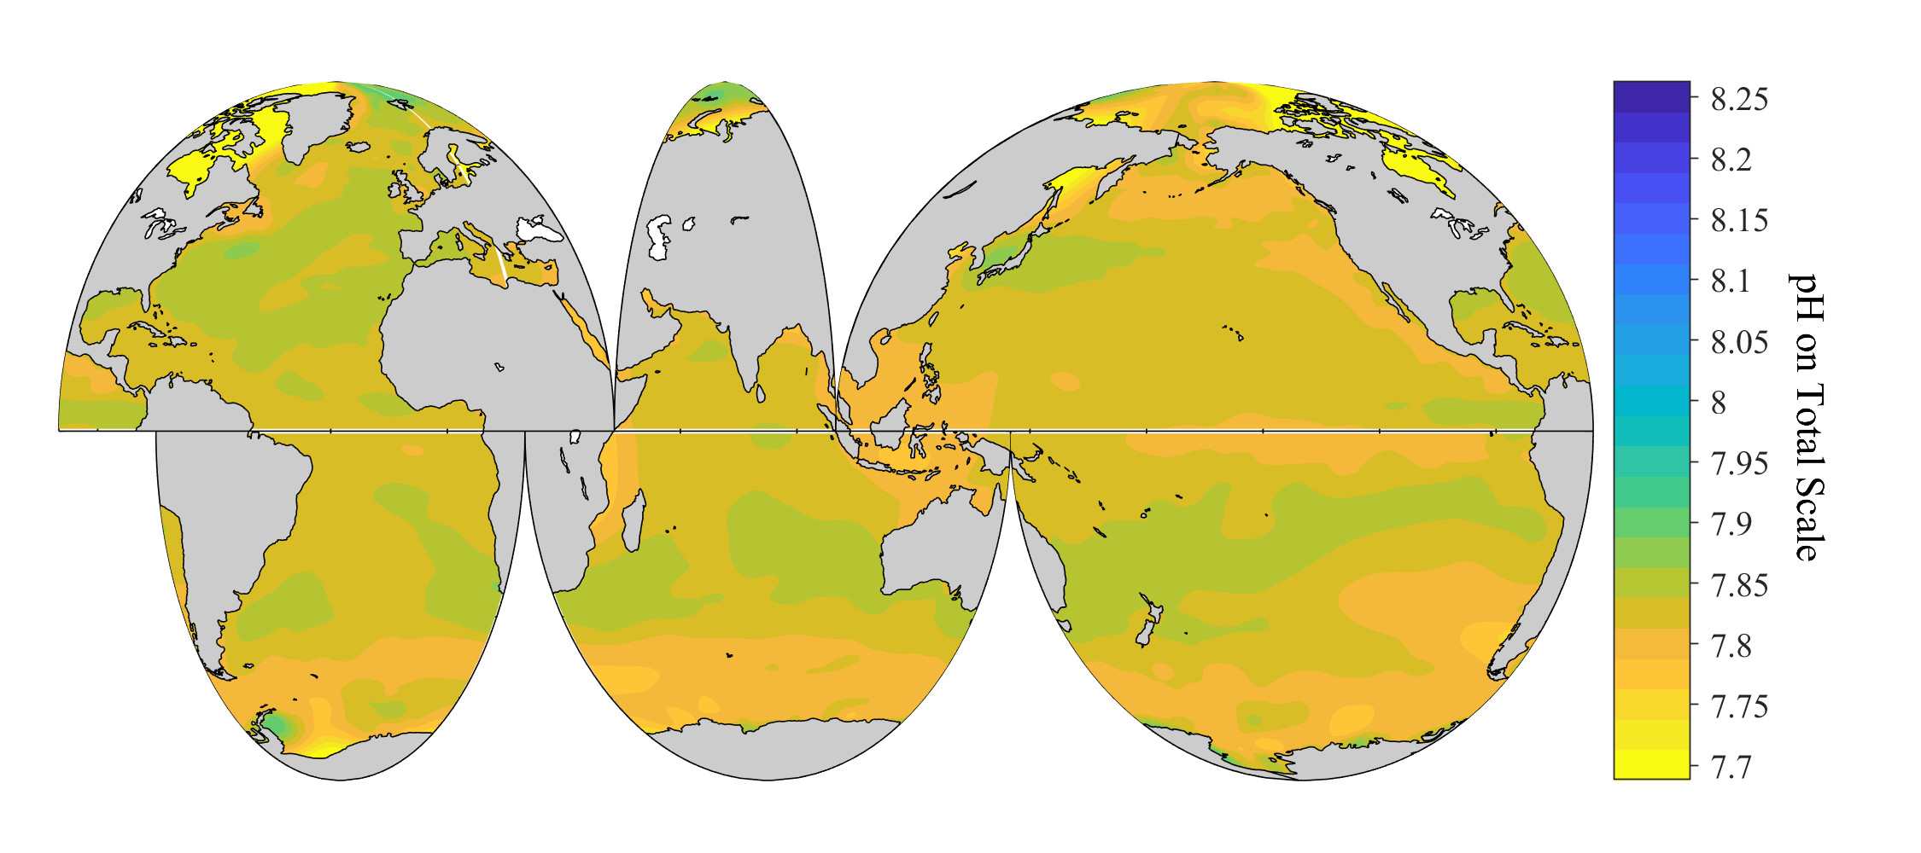
Annually averaged surface pH in 2080

Slide 12
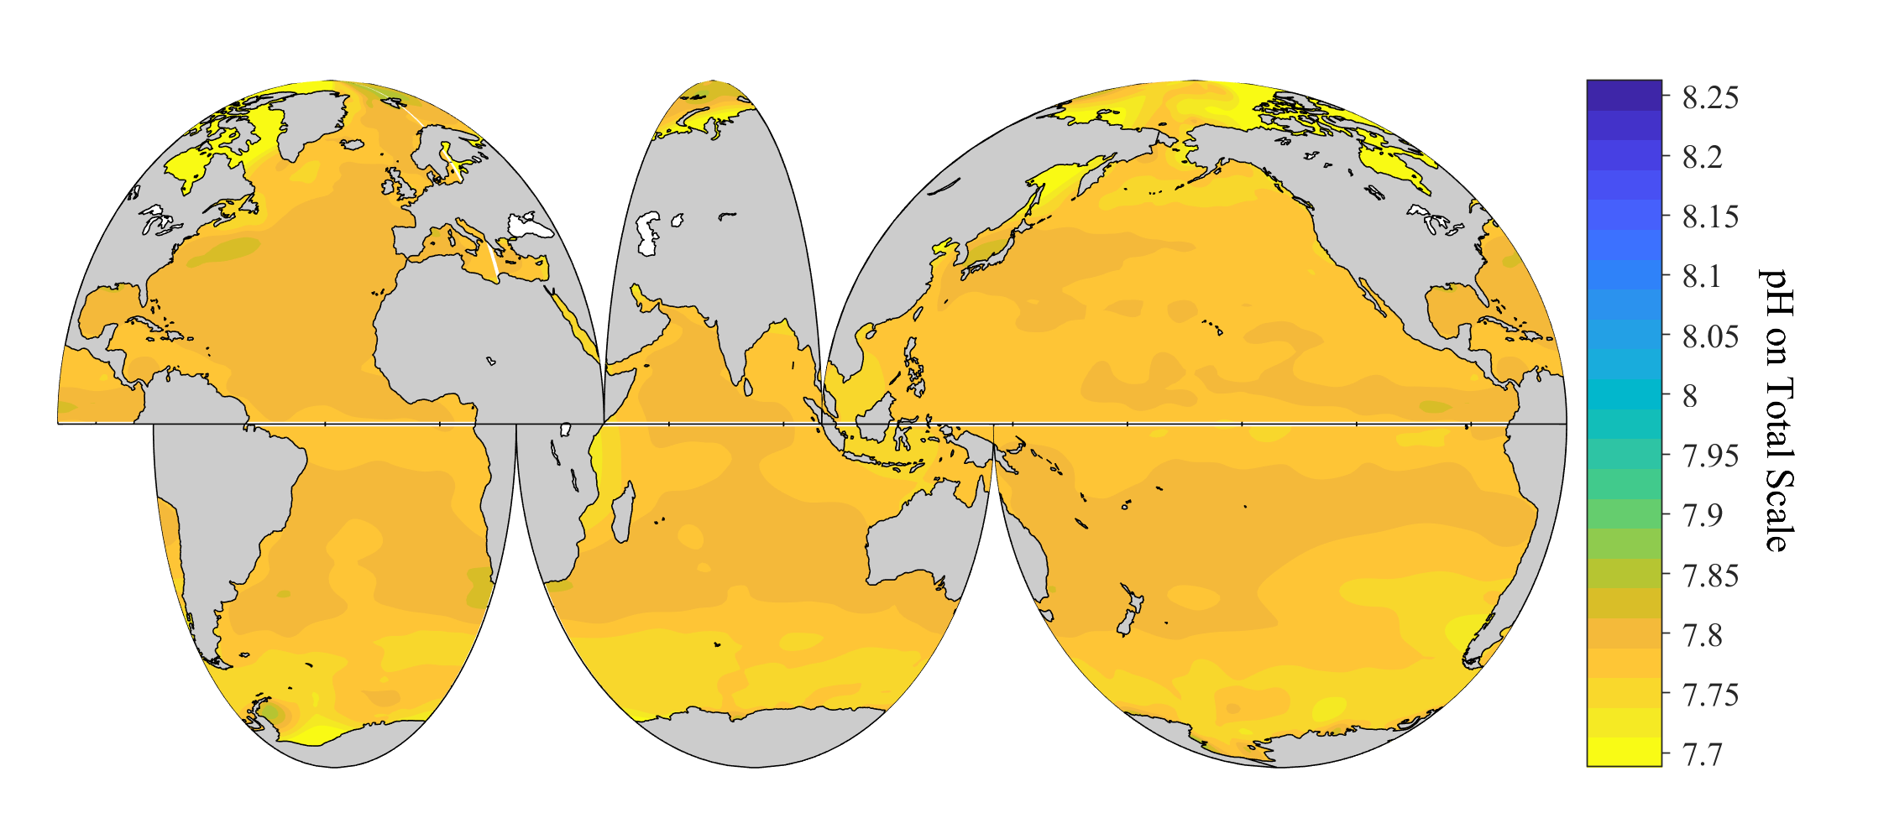
Annually averaged surface pH in 2090

Slide 13
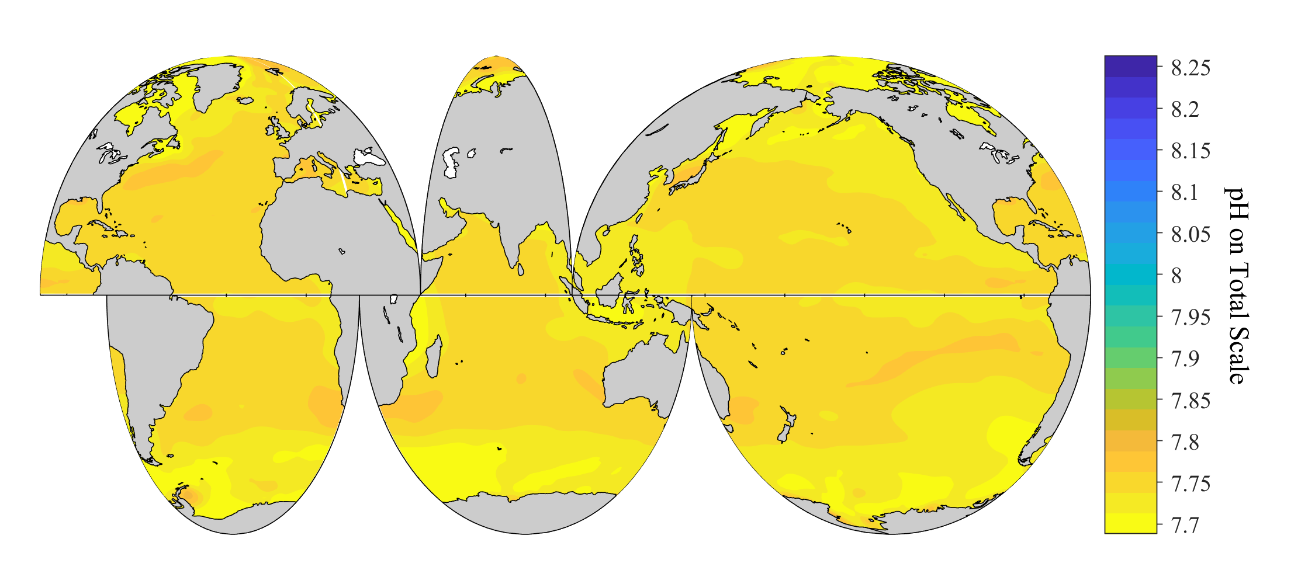
Annually averaged surface pH in 2100

