Slide 1
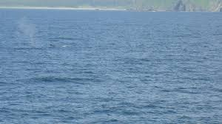
Quality Control for models/reanalysis
2nd IQuOD Workshop June 4, 2014
James A. Carton
Gennady A. Chepurin
University of Maryland

Slide 2
Data sources for SODA
NOAA/NODC WODB (using NODC bias correction)
ARGO profiles
International Council of the Exploration of the Seas (ICES) database;
Additional polar data
Woods Hole Oceanographic Institution Ice-Tethered Profile data set;
North Pole Environmental Observatory data;
Nansen and Amundsen Basin Observational System data
Assembling these data sets is a major inconvenience!

Slide 3
Preferred formats, metadata, QC flags, etc
Data Format: stable and widely used. Would prefer several alternative formats.
QC flags and device information: absolutely.
Would be nice if users could contribute to this.
Vertical resolution: Observed level data should be made available, along with high res. interpolated.

Slide 4
QC for SODA
Begin with NODC QC and bias correction
Vertical stability check
Buddy check
Comparison to climatology
Examination of O-F (how far the observation is from its forecasted value).
Poss. bad observation
Schematic of DA →
Notes:
This last check is unique to reanalysis and is the way in which results from the reanalysis can feed back into the database.

Slide 5
A reanalysis study to examine MBT/XBT bias corrections
Compares reanalyses using the Wijffels et al (2008) and the Levitus et al (2009) droprate comparisons relative to WOD05 with Hanawa et al. (1995). 1958-2002. We look at impact and we look at O-F for the observations we trust (CTD/OSDs).
J. Clim., 24, 84-93, 2011
Notes:
Small impact on the community

Slide 6
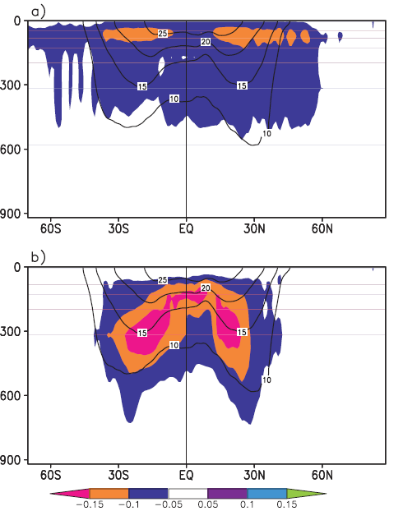
Impact of bias correction on zonally averaged temperature
Levitus – WOD05 →
Wijffels – WOD05 →

Slide 7
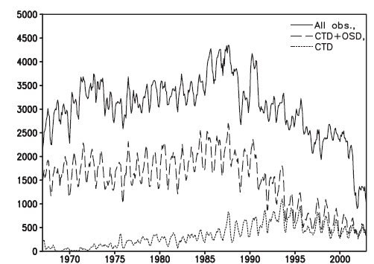
Data counts # of 1x1 deg bins filled per month

Slide 8
Global ocean heat content
Levitus
Wijffels
From O-A for the CTD/OSD

Slide 9
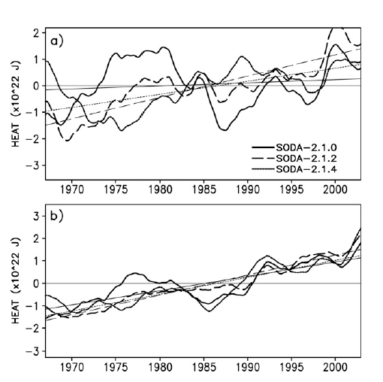
Heat content by basin
North Pacific
North Atlantic

Slide 10
O-A temp. difference for the OSD/CTD obs

Slide 11
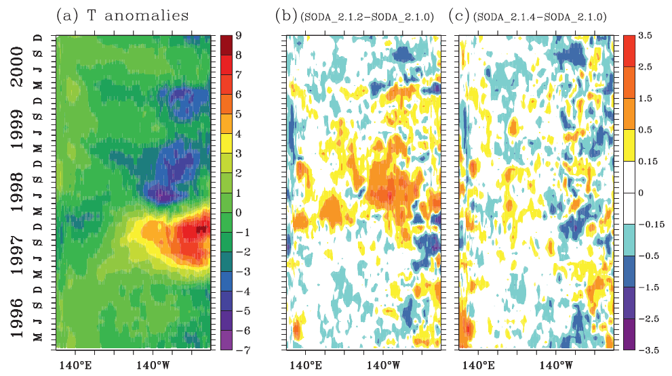
Impact on 1997/8 ENSO Temp response (0N, z=50m)

Slide 12
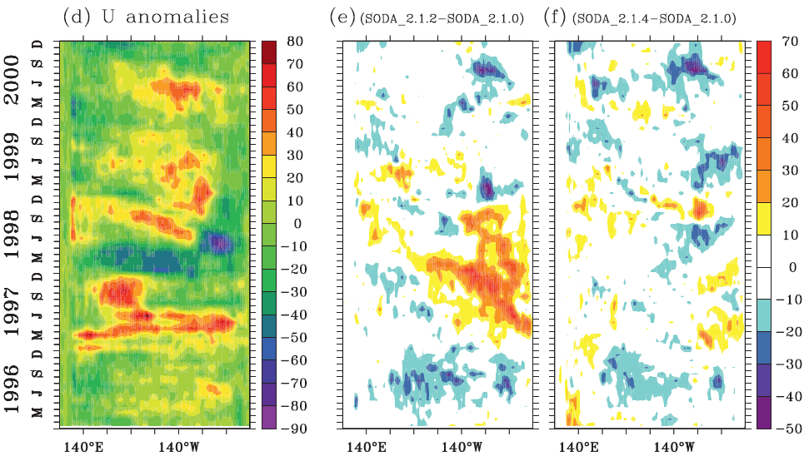
Impact on 1997/8 ENSO zonal vel response (0N, z=50m)

Slide 13
Suggestions
Applaud the IQuOD effort!
Recommend
several alternative standard data formats
Make QC flags and device information linked to obs.
Allow users to contribute flags. In particular reanalyses can be very helpful in flagging odd obs.
Vertical resolution: 1) observed levels, 2) high res. Interpolated (or interp on the fly)

