Slide 1
IODE QUALITY flag scheme FOR oceanographic and marine meteorological data
Hernan E. Garcia
(U.S. NODC, IODE Group of Experts on Biological and Chemical Data Management and Exchange Practices)
2nd IQuOD Workshop 2014, Silver Spring, MD
Co-authors: Cyndy Chandler (USA), Sergey Konovalov (Ukraine), Reiner Schlitzer (Germany), Laure Devine (Canada), Gwen Moncoiffé (UK), Toru Suzuki (Japan), Alex Kozyr (USA), Greg Reed (Australia)

Slide 2
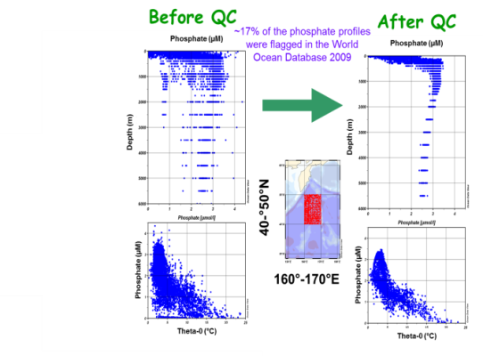
outline
Purpose and Justification
Description
Mapping example
Summary
QF “questionable” …
QF “Good” …
Why questionable or Good? What criteria was used so that I can make my own judgment.
Photo by Chris Linder (WHOI)

Slide 3
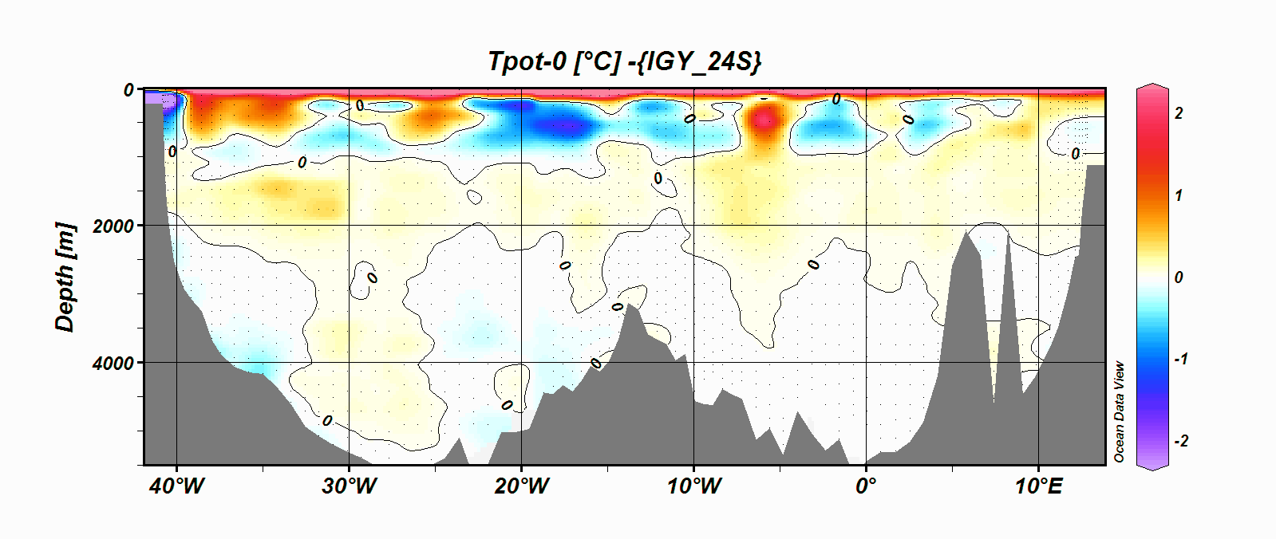
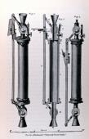
Purpose
The objectives of the recommended IODE Quality Flag Standard are:
1. to ensure data quality consistency within a single data set and within a collection of data sets,
2. to ensure that the quality and errors of the data are apparent to the user, who has sufficient information to assess its suitability for a task (fit for purpose).

Slide 4
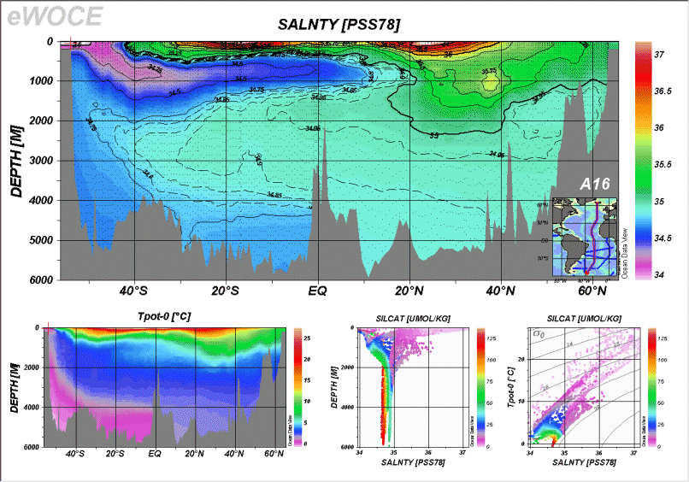
justification
We wanted a quality flag scheme that met several criteria:
Simple to use, universal, and unambiguous quality flag (QF) scheme applicable to all data variables/parameters
Contains only quantifiable assessments (metric) of data quality
Easily mapped to existing QF schemes without loss of information (mapping to existing QF schemes available)
Easy to use (logic) when generating QF for derived/calculated values (“QF inheritance”)
Einstein's razor: “Everything should be made as simple as possible, but not simpler”
Notes:
Review of QF schemes in use such as QARTOD, GTSPP, ODV, SeaDataNet, OceanSITES , BODC, WOD were created to fit individual needs.

Slide 5
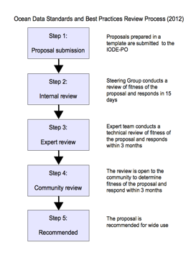
JOINT JCOMM/IODE Ocean data standards and best practices project (ODSBP)
Idea came out of IODE GEBICH workshops on QC/QA of chemical oceanographic data (2010; 2012)
ODSBP review process
ODSBP recommended Feb 2103
Proposed and accepted at IODE XXII by member states (March 2013)
Proposed to IOC/JCOMM (pending)
Notes:
The Ocean Data Standards and Best Practices Project (ODSBP)
The objective of the Project is to achieve broad agreement and commitment to adopt a number of standards and best practices related to ocean data management and exchange. The project is a continuation of the Ocean Data Standards Prilot Project (ODS), established and implemented jointly between JCOMM and IODE. The ODSBP project was established by IODE-XXII (2013) through Recommendatio IODE-XXII.6.

Slide 6
IODE Data Quality Flag Scheme
A flag scheme to enable exchange of oceanographic and marine meteorological data
Published in April 2013 as a UNESCO/IOC Manuals and guides No. 54 - Volume 3: Ocean Data Standards: Recommendation for a Quality Flag Scheme for the Exchange of Oceanographic and Marine Meteorological Data
Cite as: Intergovernmental Oceanographic Commission of UNESCO. 2013. Ocean Data Standards, Vol.3: Recommendation for a Quality Flag Scheme for the Exchange of Oceanographic and Marine Meteorological Data. UNESCO, Paris, France. (IOC Manuals and Guides, 54, Vol. 3.) 12 pp. (English) (IOC/2013/MG/54-3) http://www.iode.org/mg54_3
Notes:
Ocean Data Standards volume 3: Recommendation for a Quality Flag Scheme for the Exchange of Oceanographic and Marine Meteorological Data, available as UNESCO/IOC Manuals and Guides No. 54 - Volume 3, Version 1, 18 April 2013
http://www.iode.org/mg54_3
Cite as: Intergovernmental Oceanographic Commission of UNESCO. 2013. Ocean Data Standards, Vol.3: Recommendation for a Quality Flag Scheme for the Exchange of Oceanographic and Marine Meteorological Data. UNESCO, Paris, France. (IOC Manuals and Guides, 54, Vol. 3.) 12 pp. (English) (IOC/2013/MG/54-3) http://www.iode.org/mg54_3

Slide 7
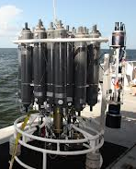
Quality flag Scheme
Two-level quality flag scheme (QF)
The primary level defines the data quality flags only (intended for data users that need only basic data quality flags),
The secondary level (recommended), complements the first level by providing the justification for the quality flags, based on quality control tests or data processing history (fit for purpose)

Slide 8
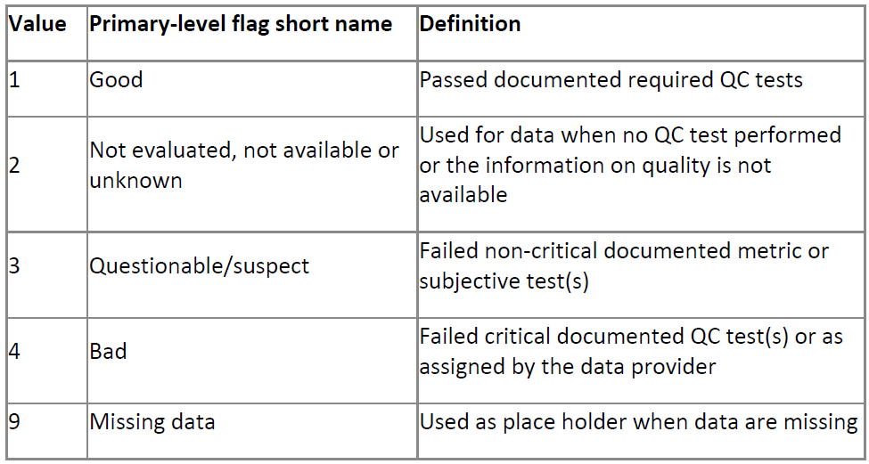
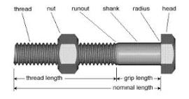
QUALITY FLAGS: Primary level
Notes:
The ODS Quality Flag Scheme was developed by a committee comprising representation from several different countries. It is a two-level system. The first, or primary, level defines the data quality flags only. The secondary level complements the primary level by providing the justification for the quality flags, based on quality control tests or data processing history. The two level scheme enables the small number of unambiguous flags at the primary level to be optionally justified by the details represented in the second level. Primary-level flag values are numeric and ordered such that increasing quality flag values indicate a decreasing level of quality. This supports the identification of all data that meet a minimum quality level and facilitates assignment of quality flags to calculated parameters.

Slide 9
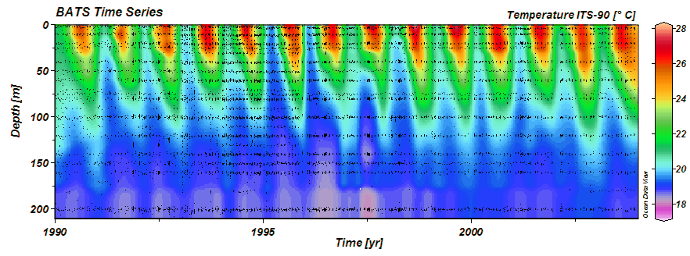
Example of PRIMARY LEVEL data quality filtering and/or processing, including inheritance of quality flag values for derived variables
Example, calculate seawater density from temperature and salinity.
In situ temperature “good” QF=1
Salinity “unknown” QF=2
Calculated density QF=2
The quality of the calculated value inherits the lowest quality qualifier of the variables used in the calculation.

Slide 10
QUALITY FLAGS: second level
The secondary level complements the primary level flags by reporting the results of specific QC tests performed and data processing history.
Content varies in number and description and is chosen by those who implement the scheme,
Represents information on the applied quality tests (e.g., excessive spike check, regional data range checks, data processing history such as interpolated values, corrected values, etc).

Slide 11
Second level example of quality control tests and data processing history
Example quality control tests / data processing history (description)
Globally impossible value
Monthly climatology standard deviation test
Excessive spike check
Excessive offset/bias when compared to a reference data set
Excessive data uncertainty
Unexpected X/Y ratio (e.g., chemical stoichiometry or property-property X to T, S, density, among others)
Excessive spatial gradient or pattern check (“bullseyes”)
Below detection limit of method
Interpolated value (not measured)
Data offset corrected value relative to a reference data
Expert review

Slide 12
Table B.3. An example of mapping the GTSPP scheme to the proposed quality flag scheme.
GTSPP scheme |  | Proposed quality flag scheme |  |  | Comments
Flag code | Flag description | Primary-level flag code | Primary-level flag description | Secondary-level flag description (held in a code table)
0 | No quality control has been assigned | 2 | Not evaluated, not available or unknown | Sample collected but QC tests were not applied
1 | QC was performed; appears to be correct | 1 | Good | Expert review | Unless the exact list of quality checks is provided
2 | QC was performed; probably good | 1 | Good | Expert review | Unless the exact list of quality checks is provided
3 | QC performed; appears doubtful | 3 | Questionable | Expert review | Unless the exact list of quality checks is provided
4 | QC performed; appears erroneous | 4 | Bad | Expert review | Unless the exact list of quality checks is provided
5 | The value was changed as a result of QC | 1 | Good | Changed value; Expert review | Once checks are applied, secondary flags are added.
9 | The value is missing | 9 | Missing data | Not reported

Slide 13
Summary
A common data QF scheme is proposed with several advantages:
Small number of primary-level flag values that are numeric and ordered such that increasing quality flag values indicate decreasing level of quality.
supports identification (filtering) of data that meet a minimum quality level and assignment of quality flags to calculated parameters
Facilitates data exchange and mapping between QF schemes without loss of information. Everyone can keep using their QF schemes.

