Slide 1
Getting Historical Data into the Word Ocean Database
Ocean Climate Laboratory Team/NODC

Slide 2
World Ocean Database (WOD)
A quality controlled collection of ocean profiles, plankton tow , and ship-based surface measurements from 1772-present.

Slide 3
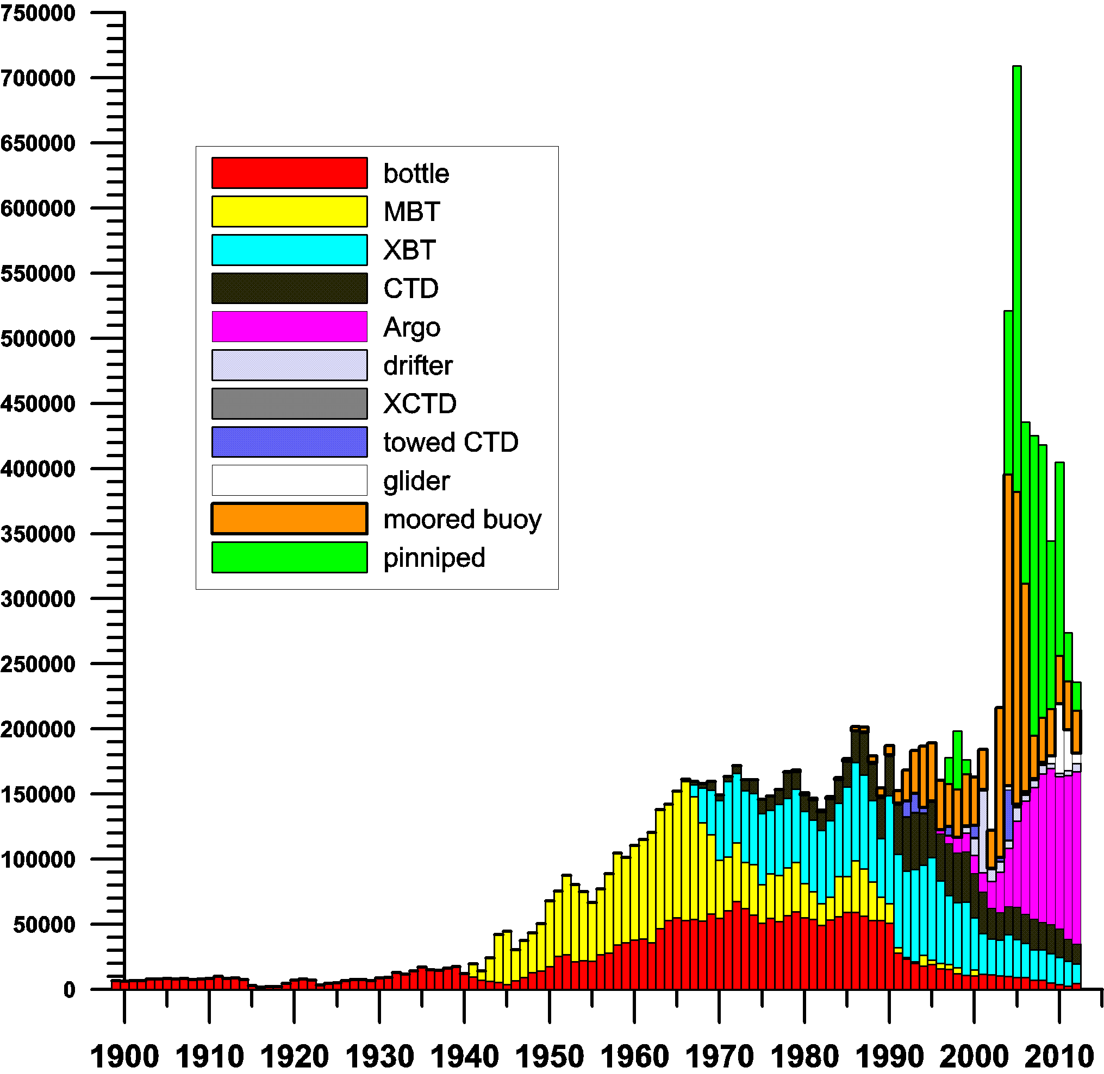
WOD by Instrument Type

Slide 4
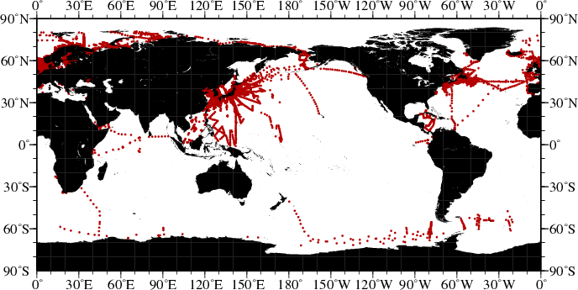
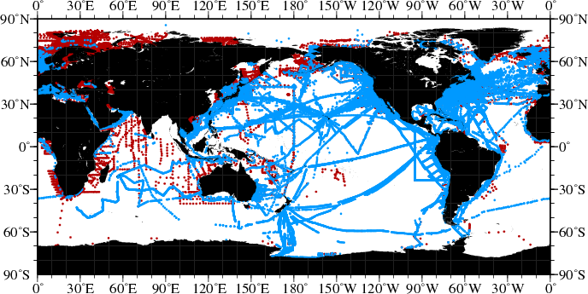
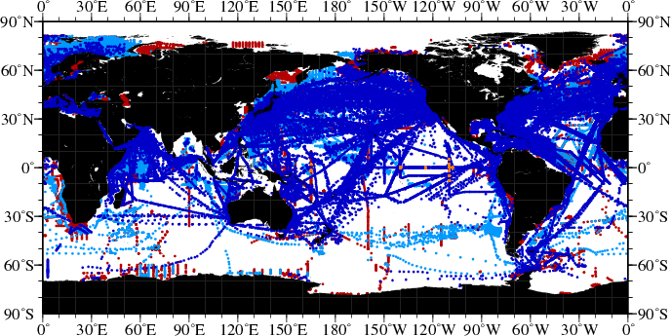
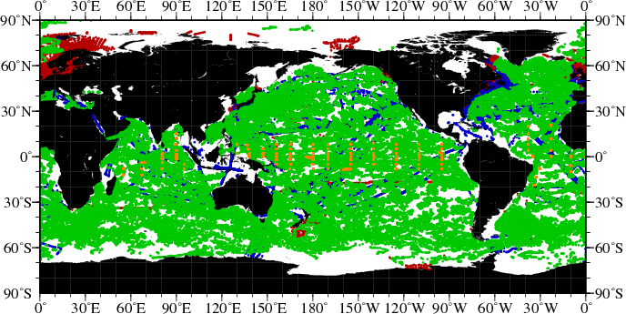
Temperature Data During Peak of Different
Observing Systems
1934 : Nansen Cast
1960 : MBT
1985 : XBT
Red=Nansen Cast /CTD[1890s/1964]
Light Blue=MBT [1939]
Dark Blue=XBT [1967]
Green=Argo float [2001]
Orange=Tropical buoy [1984]
2009 :
Argo
Abraham et al., 2013

Slide 5
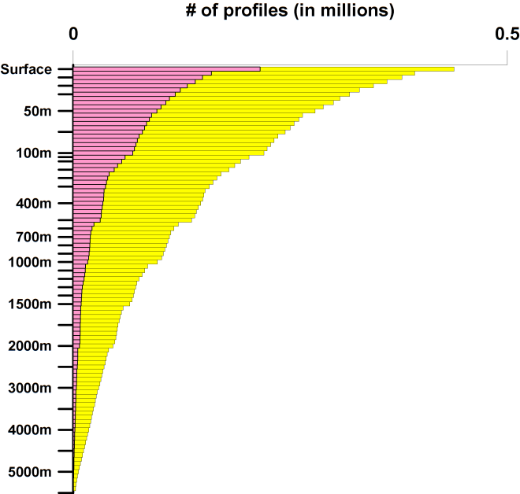
Measurements vs. Depth WOD13
Depth (m)
Depth (m)
Green – Temperature
Red – Salinity
Yellow – Silicate
Pink - Chlorophyll

Slide 6
World Ocean Database
Contains contributions from national
data centers, universities, special projects,
fisheries, navies, government agencies, individual scientists, merchant ships etc.
Data found on internet, index cards, glass slides, outdated computer media, published cruise reports, etc.
Original data must be accessible in the NODC archive/permission must be obtained for all data

Slide 7
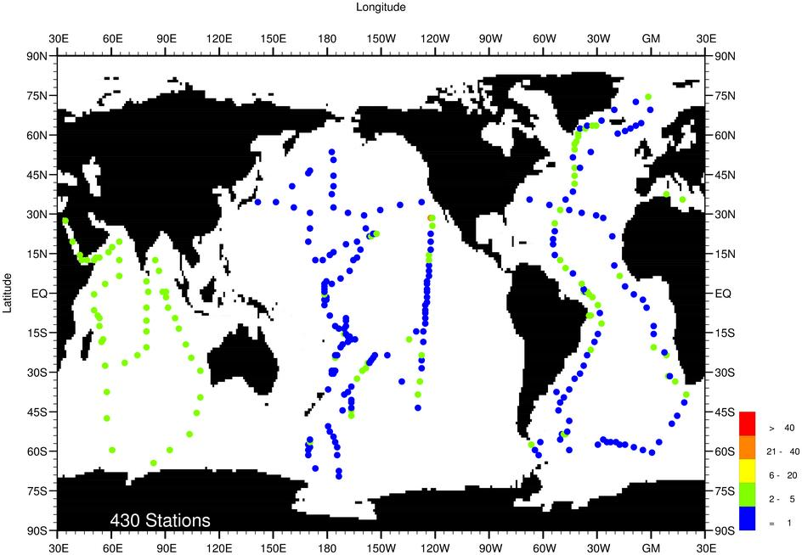
Data from international projects
Left: GEOSECS bottle
and CTD data (1972-1979)
Right: WOCE CTD data
(1990-1998)

Slide 8
Data from universities, fisheries
Left: Bottle data from
Hokkaido University (Japan)
(1962-1994)
Right: Temperature Data from
US National Marine Fisheries
(1964-1997)

Slide 9
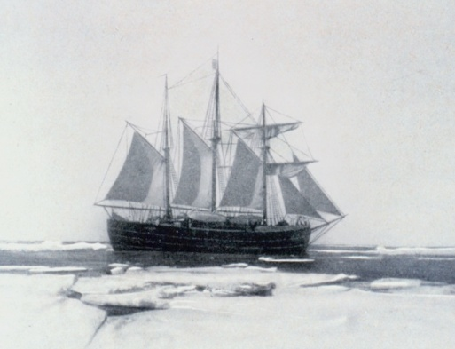
Data Archeology and Rescue
Nansen’s Arctic expedition, 1893-1896
Fram (1892 – 1912)
Trial cruise
Photo: wikipedia
Amundsen’s South Pole expedition, 1910-1912
* No data from Sverdrup’s Canadian Archipelago expedition (1898-1902)

Slide 10
Data Archeology and Rescue
0. Find digital data source ×
Locate cruise report ✓
Scan Document ✓
2. Digitization: Double Key Entry
Crowd sourcing?
3. Enter into WOD

Slide 11
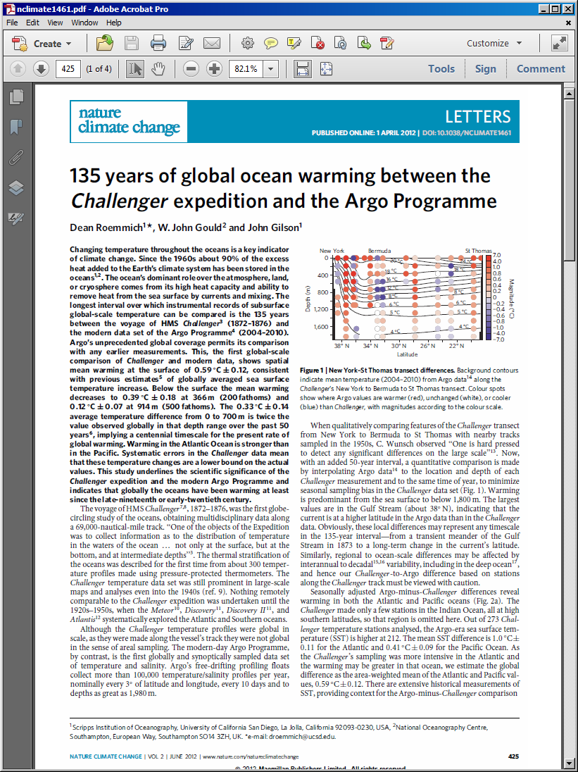
Data Archeology and Rescue
Iterative Process
HMS Challenger data in WOD – digitized from UK Met Office Index cards.
J. Gould digitized from Challenger cruise report – is preparing to supply to NODC: more casts?

Slide 12
Data Archeology and Rescue
Cruise Reports found:
Red/Yellow: Library of
University of Tromso, Norway
Blue: Public Library, St. Petersburg, Russia
Green: Public Library, New York City, USA (in part)

Slide 13
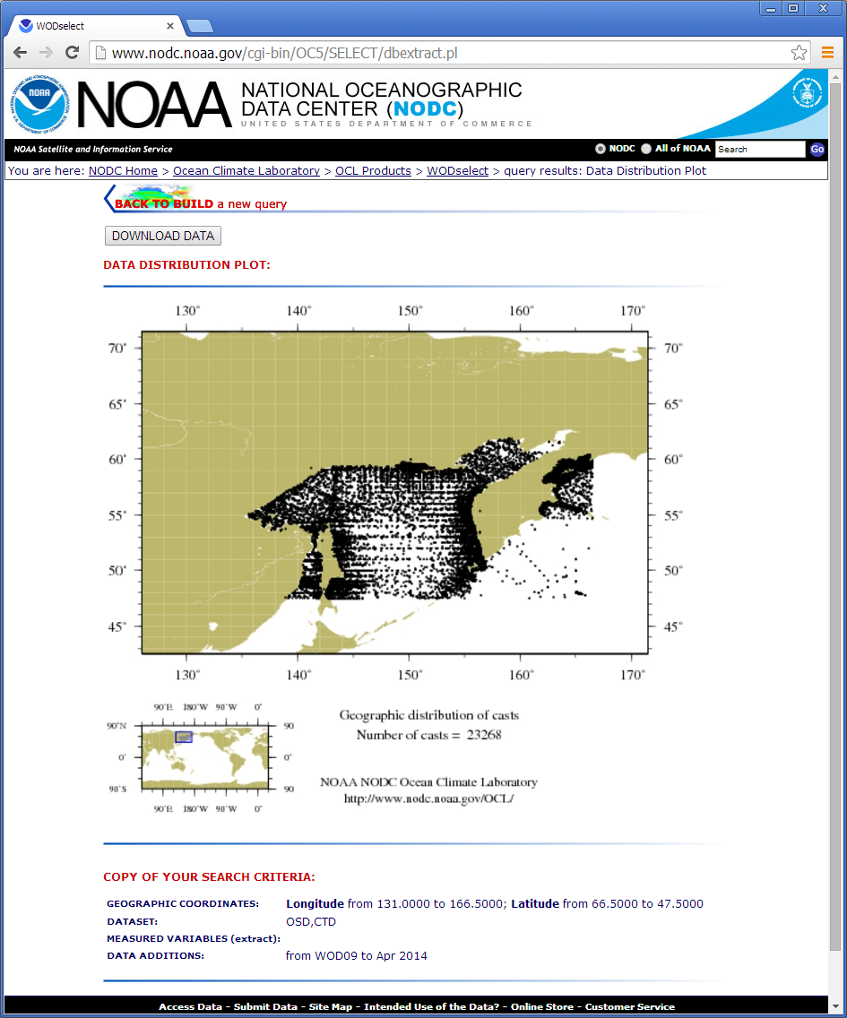
Are there still data to be rescued?
WOD09: 20,886 bottle/CTD casts in the Sea of Okhotsk
WOD13: 29,160 bottle/CTD casts in the Sea of Okhotsk
April, 2014 update: 43,554 bottle/CTD casts in the Sea of Ohkotsk
22,886 casts added, mostly from the Russian Far East Institute
Years for which data were added: 1803-2013

Slide 14
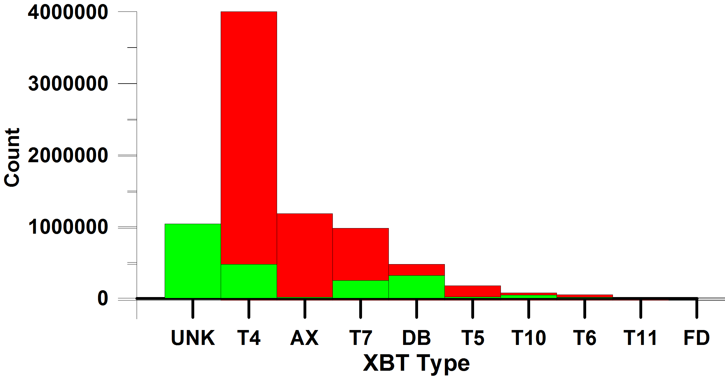
Are there still data to be rescued?
From Jim Hannon, Sippican Inc. email Aug. 7, 2002
‘To date, nearly 7 million [XBTs] have been produced’
‘On 10 December 1972, Sippican produced its 1,000,000 XBT’
In WOD: 1.99 million XBTs dated Aug. 7, 2003 or prior
0.28 million XBTs dated Dec. 10, 1973 or prior
Drops to Aug. 7, 2003
Red Sippican Estimate
Green in WOD

Slide 15
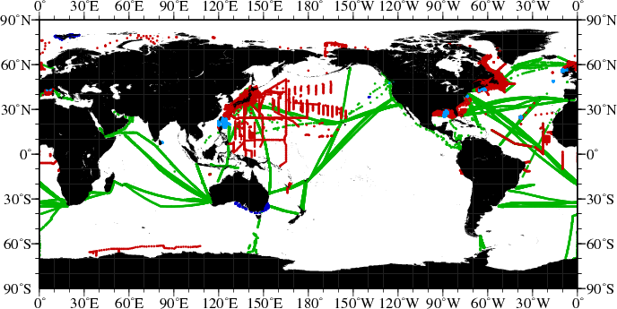
Near-real time data from GTSPP: 2013
Green – XBT (16,173 casts)
Red – CTD (14,521 casts)
Blue - Pinniped (3,970 dives)
Turquoise – Glider (20,499 half cycles)

Slide 16
Examples of Delayed-mode data Updates to WOD
ICES
CCHDO
Blue – Quarterly
Orange- Yearly
Green - Irregular
WHOI Ice
Tethered Buoys
TAO maintenance
cruises
CalCOFI
World Ocean
Database Quarterly
Updates
NOAA
Northeast
Fisheries
Japan Ocean
Data Center
INIDEP
(Argentina)
CSIRO
Line W

Slide 17
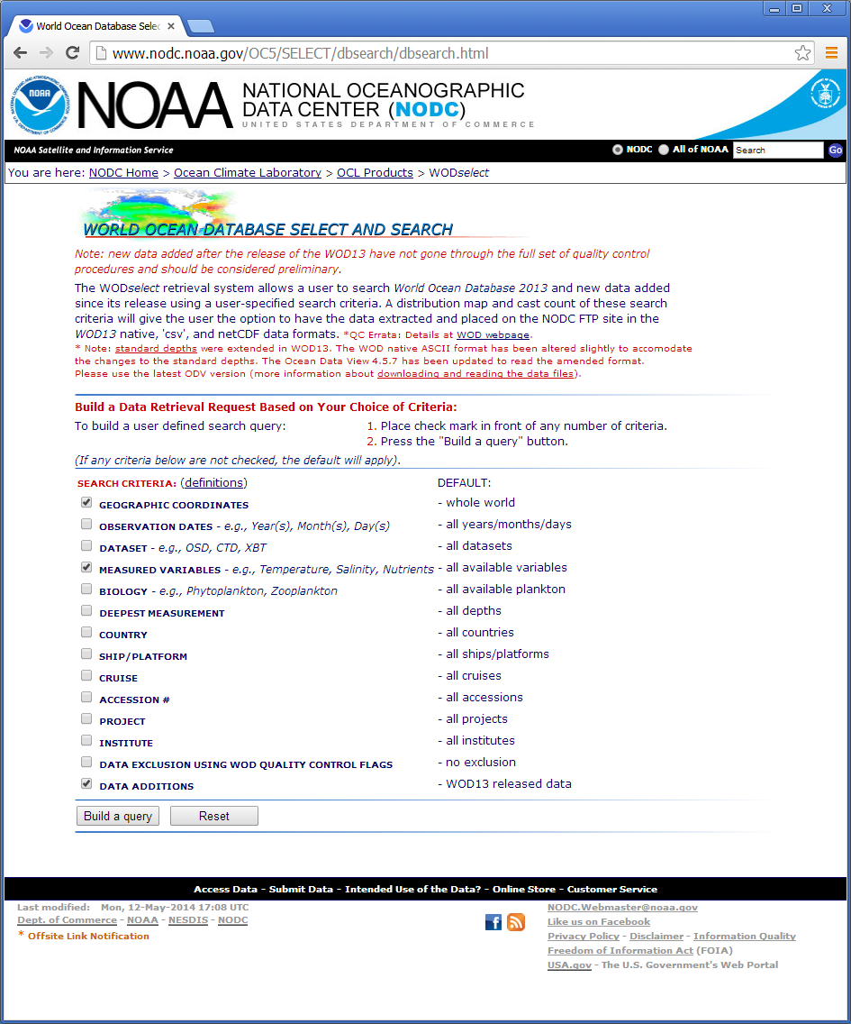
Data Dissemination:
Yearly by instrument
Geographically by instrument
WODselect
All updated quarterly
Format:
Native WOD format
(compact ASCII) with conversion
routines
netCDF -> feeds into
NODC Geoportal/THREDDS server
Working now on subset dissemination through Geoportal

Slide 18
What we do
Go to meetings – ask: are data at US NODC?
Read journals – ask: are data at US NODC?
Scour web – ask: are data at US NODC?
Word of mouth – ask: are data at US NODC?
Set up automated archiving
Maintain contacts with data centers/projects
Education on handling/archiving data
Get our own house in order (NOAA data)

Slide 19
Obstacles
Simply not enough resources to go to all meetings, read all journals, scour all websites
Data restrictions – some form of access control/agreement
“I don’t want my data in WOD” – insufficient recognition of scientists/data managers
Reluctance to release data – either data are not final or research is not complete
No time for provider to prepare data

Slide 20
What you can do
Alert US NODC of data sources
Obtain permission to remove data restrictions
Educate submitters on points of recognition in WOD – tell us how to have better attribution
Persuade data holders to release data
Assist data holders in preparing and disseminating data

Slide 21
Thank you

