Slide 1
Metadata Recovery : How?
Glean information from cruise reports and journal publications
Contact primary investigators, data managers
Go back to original archived data
Often simple solutions, but resources to implement are lacking
Some metadata will never be recovered

Slide 2
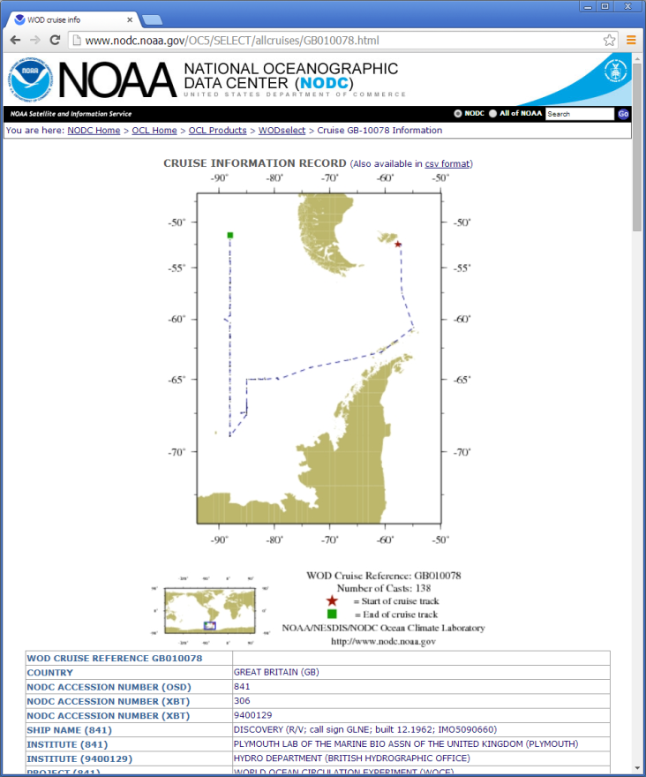
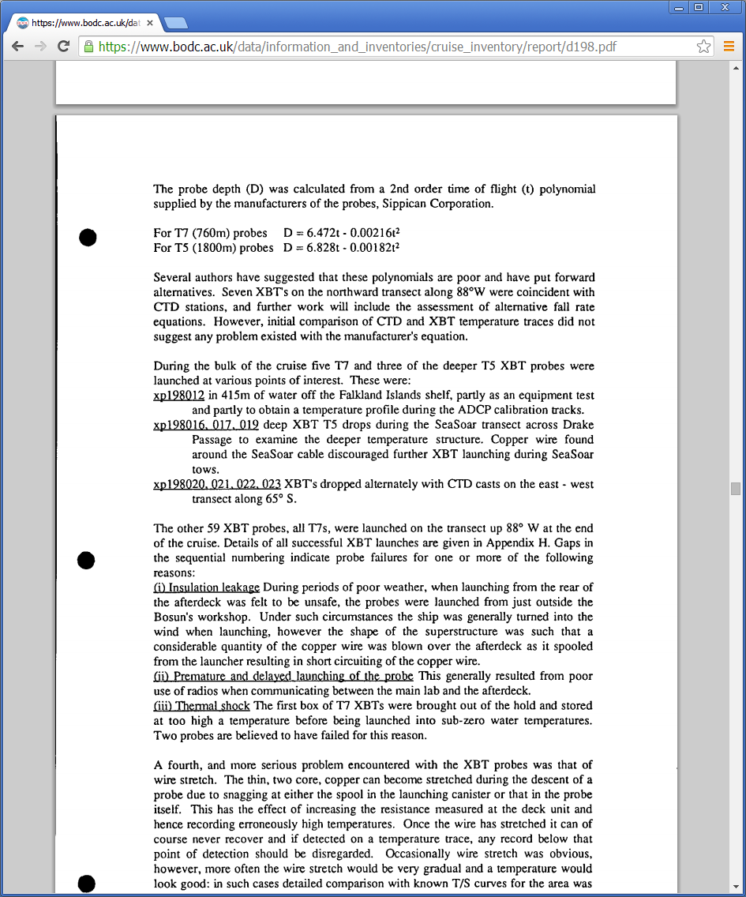
RRS Discovery Cruise Nov. 1992
66 XBTs – not all XBT types identified in WOD
Cruise Report online (BODC)
Same cruise – details XBT type for each drop. Also includes CTD calibration information

