Slide 1
IQuOD website
Rebecca Cowley

Slide 2
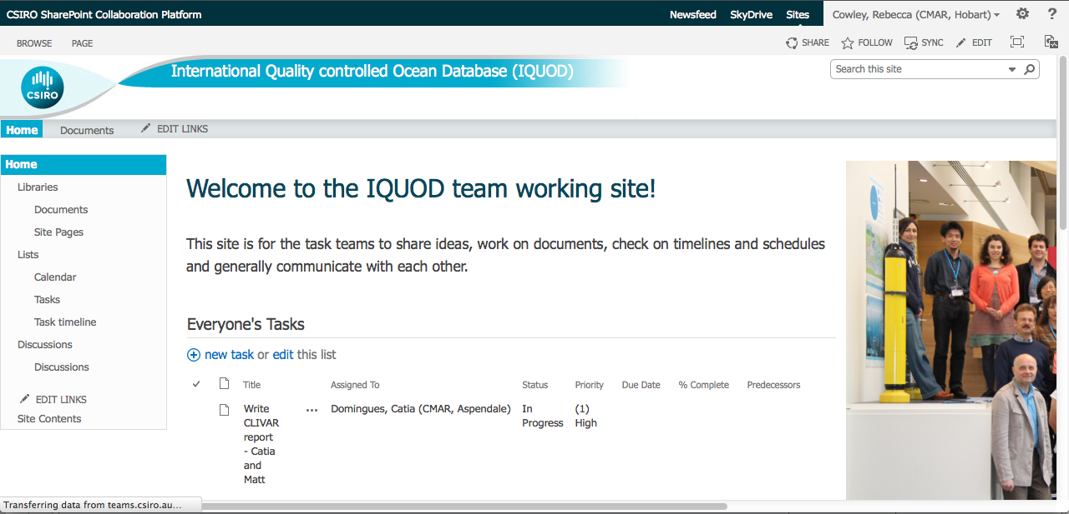
Collaboration site
https://teams.csiro.au/sites/IQUOD/SitePages/Home.aspx

Slide 3
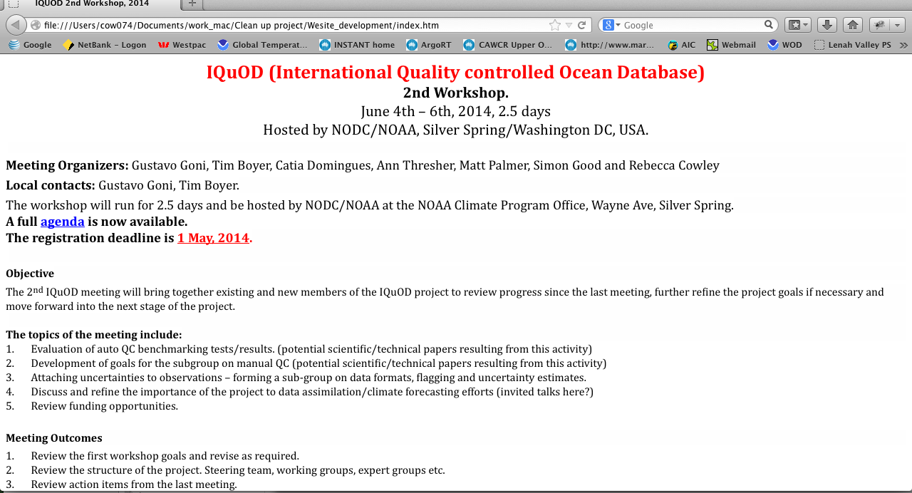
www.iquod.org

Slide 4
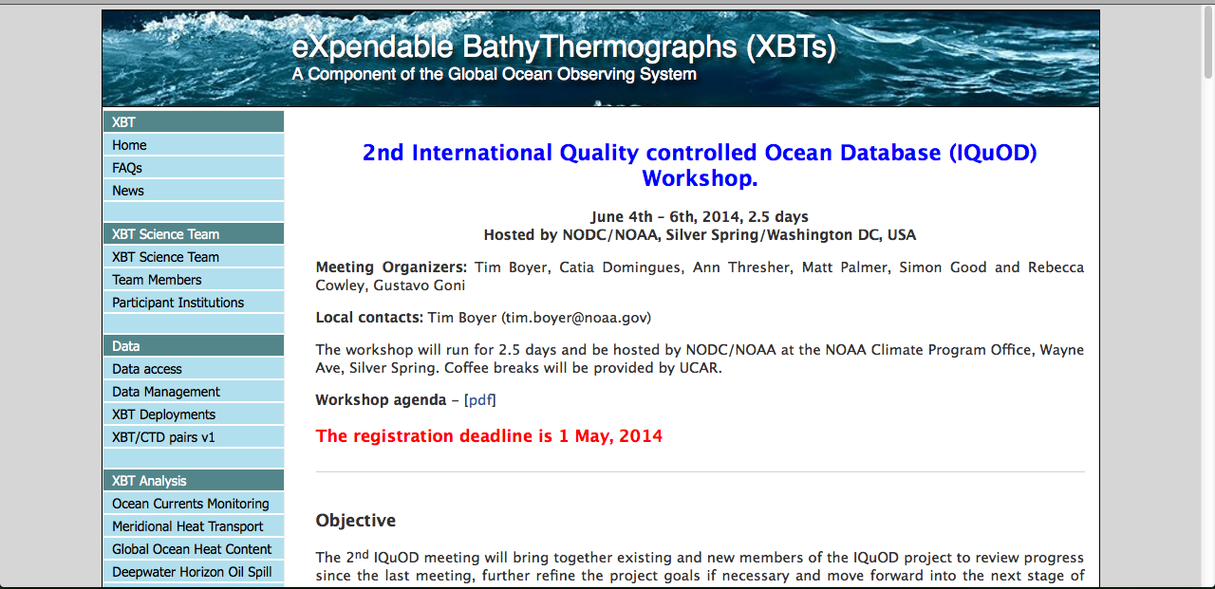
Page hosted by NOAA
http://www.aoml.noaa.gov/phod/goos/xbtscience/meetings_load.php?ID=2ndIQuOD

Slide 5
Where to?
Ask for in-kind assistance in developing the web site at www.iquod.org.
Allow some committee members access to update as required
Have a password protected page with access to documents, powerpoints etc.

Slide 6
Webpage specs
Landing/Home page Elements:
Search box
Members login box/registration request
Participant logos along the bottom
Photos/Links to the other pages, like the SOOS landing page?
http://soos.aq/
Menu bar (top or on left)
  Home
  About us
    What is IQuOD?
    Who’s who?
  News
  Products
  Calendar
  Documents and Progress reports
    Progress reports
    Documents (members only)
  Contact Us
  Links

